Slide 1
Project № 1 «Young people’s success stories»
10th form
Merkova alexandra
Yuriev- Polsky
2019

Slide 2
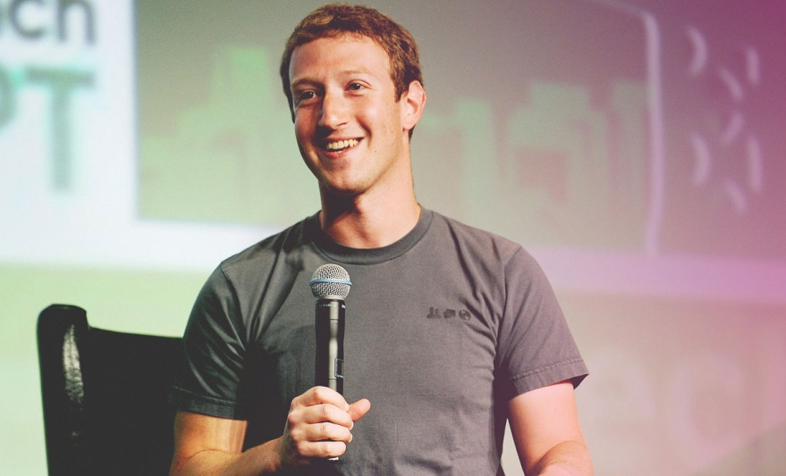
Now I want to tell you about one of the young people's successful stories.
My story is about Mark Elliot Zuckerberg. He's an american programmer, who designed and created social network "Facebook". Now he leads the company "Facebook Inc".

Slide 3
Biography
Mark was born on the 14th of May in 1984 in White Plains (NY). His father is Edward Zuckerberg, he works as a dentist. And his mother is Karen Zuckerberg. She's psychiatrist. Mark has 3 sisters. He has been involved in a computer programming since he was 10 years, when his father gave him his first personal computer. He was fond of computer programming at school and he was the developer of a network version of games "Risk". Then Mark entered the Harvard University at the department of Psychology, at the behest of his mother. But at the same time, he visited courses of informatics and practiced his skills in the field of programming. He created a lot of programs, for example, "Facemash", " CourseMatch".

Slide 4
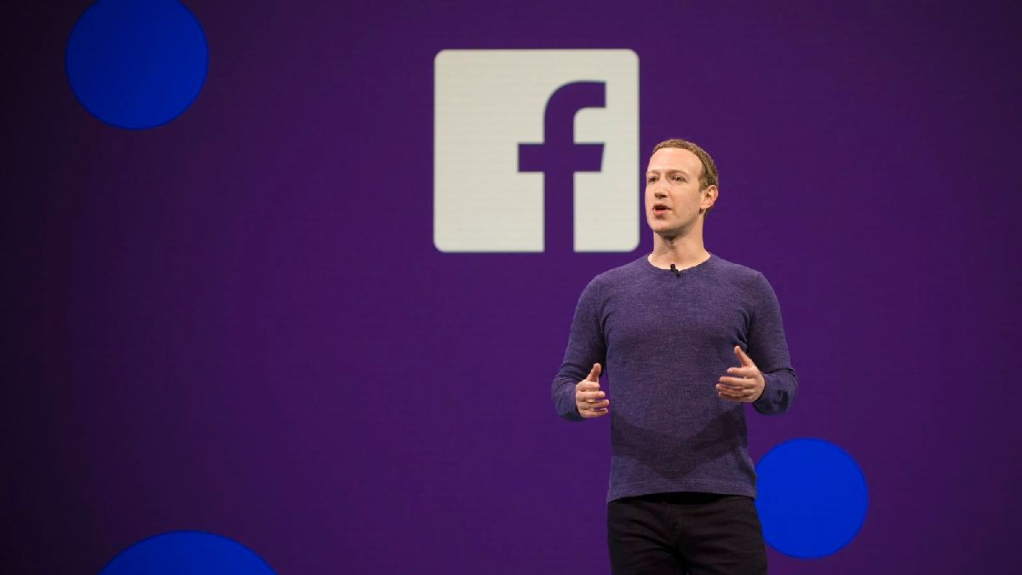
Facebook
So, based on the "Facemash" program, Mark with his friends Chris Hughes, Dustin Moskovitz and Eduardo Saverin created a communication masterpiece in the form of the "Facebook" social network, which expanded the communication of Harvard students on the local network. A few days later, the Facebook project crossed the border of the Harvard University, which was joined by the Ivy League universities in Boston, New York and Canada. The idea of ​​a social network was to place photos and different information on the pages by users - from scientific to everyday interests. Soon, Mark left the Harvard and decided to fully engage in his project. And he did it. In 2015, Facebook became the second most visited website in the world and Mark Zuckerberg was the youngest dollar billionaire with an official salary of $ 1. In 2017, the number of Facebook users reached 2 billion.

Slide 5
Charity Visit to Russia
In 2015, Zuckerberg announced that he will donate almost his money to charity. In 2016, Mark Zuckerberg and his wife Priscilla Chan announced the launch of a new project - Chan Zuckerberg Science.The project aim to control various diseases.
Mark visited our country in 2012. Zuckerberg met with D. A. Medvedev and took part in two programs on Channel One. Also he gave an open lecture about himself and the history of Facebook to students of Moscow State University named Lomonosov.

Slide 6
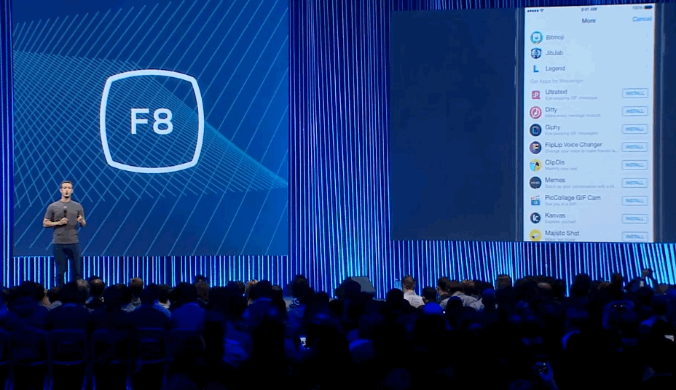
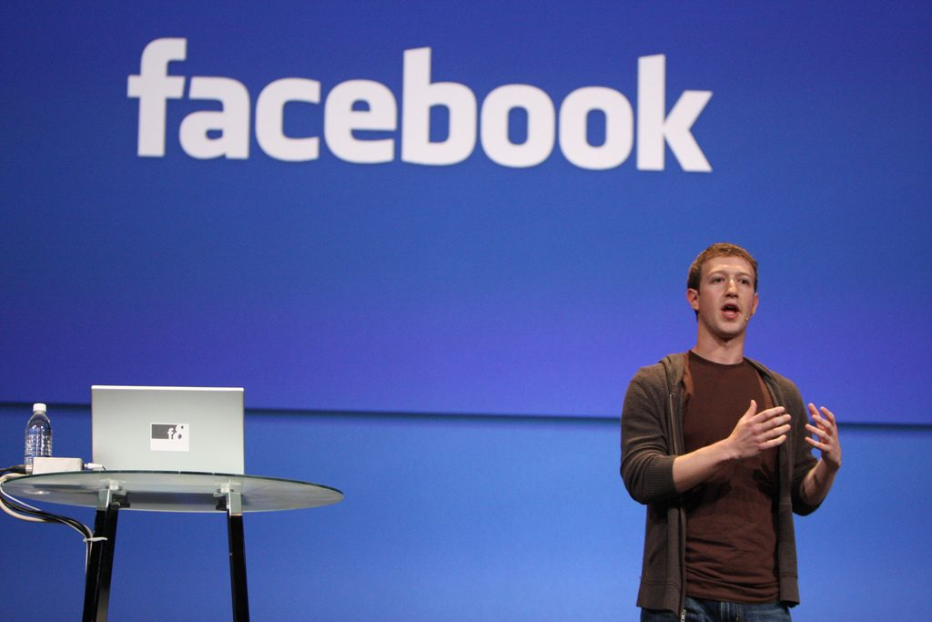
Nowadays
The fortune of 35-years-old Mark Zuckerberg for 2019, according to Forbes, amounted to $ 69 billion. This means that he has become richer than Google’s founders Sergey Brin and Larry Page.

Slide 7
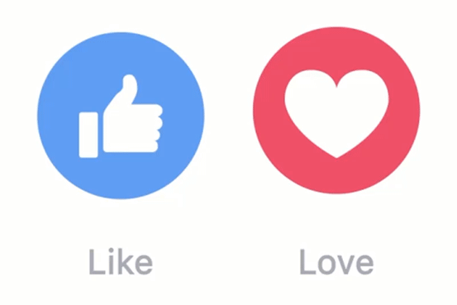
That's all I wanted to tell you about this smartest young man. I hope there will be more such outstanding people in our world.

