Slide 1
«Some FaCTS about Great Britain»
The 21st of May

Slide 2
Articles with geographical names
with article THE | NO article (-)
Oceans, straits, seas, canals, waterfalls, groups of islands, groups of lakes, mountains chains, gulfs, deserts, regions With words Republik, Union, States, Kingdom With abbreviations: the USA, the UK, the USSR | Cities*, countries**, continents, lakes, peaks, mountains, bays, But: *the Hague ** the Netherlands

Slide 3
Fill in the Gaps with the/ -
____Oxford ____English Channel
____River Thames ____UK
____British Isles ____Highlands
____London ____Ben Nevis
____Scotland ____Lake Loch Ness

Slide 4
Answers
__-__Oxford _the_ English Channel
the_River Thames _the_UK
_the_British Isles _the_ Highlands
__-__London __-__ Ben Nevis
__-__Scotland __-__ Lake Loch Ness
0-1 mistakes 5
2-3 mistakes 4
4-5 mistakes 3
6 and more 2

Slide 5
Watch the Video and make the task!

Slide 6
Match the words with their definition
food which is made with cereal usually oats(the oats are boiled in water, milk or broth)
a small round cake that is like bread made from flour, milk and little fat
hard yellow cheese with a nutty flavour
hot dish consisting of fried fish in batter served with potato chips.
dish for breakfast consisting of fried eggs
traditional Scottish dish –stomach of a sheep stuffed with a mixture of chopped sheep’s heart, liver and lungs, onions, fat and seasoning
Fish and chips
Cheddar
Bacon and eggs
Scone
Haggies
Porridge

Slide 7
What is the Name of the British Flag?

Slide 8
Call the name of this construction!

Slide 9
What is the Name of official residence of Queen Elizabeth II?

Slide 10
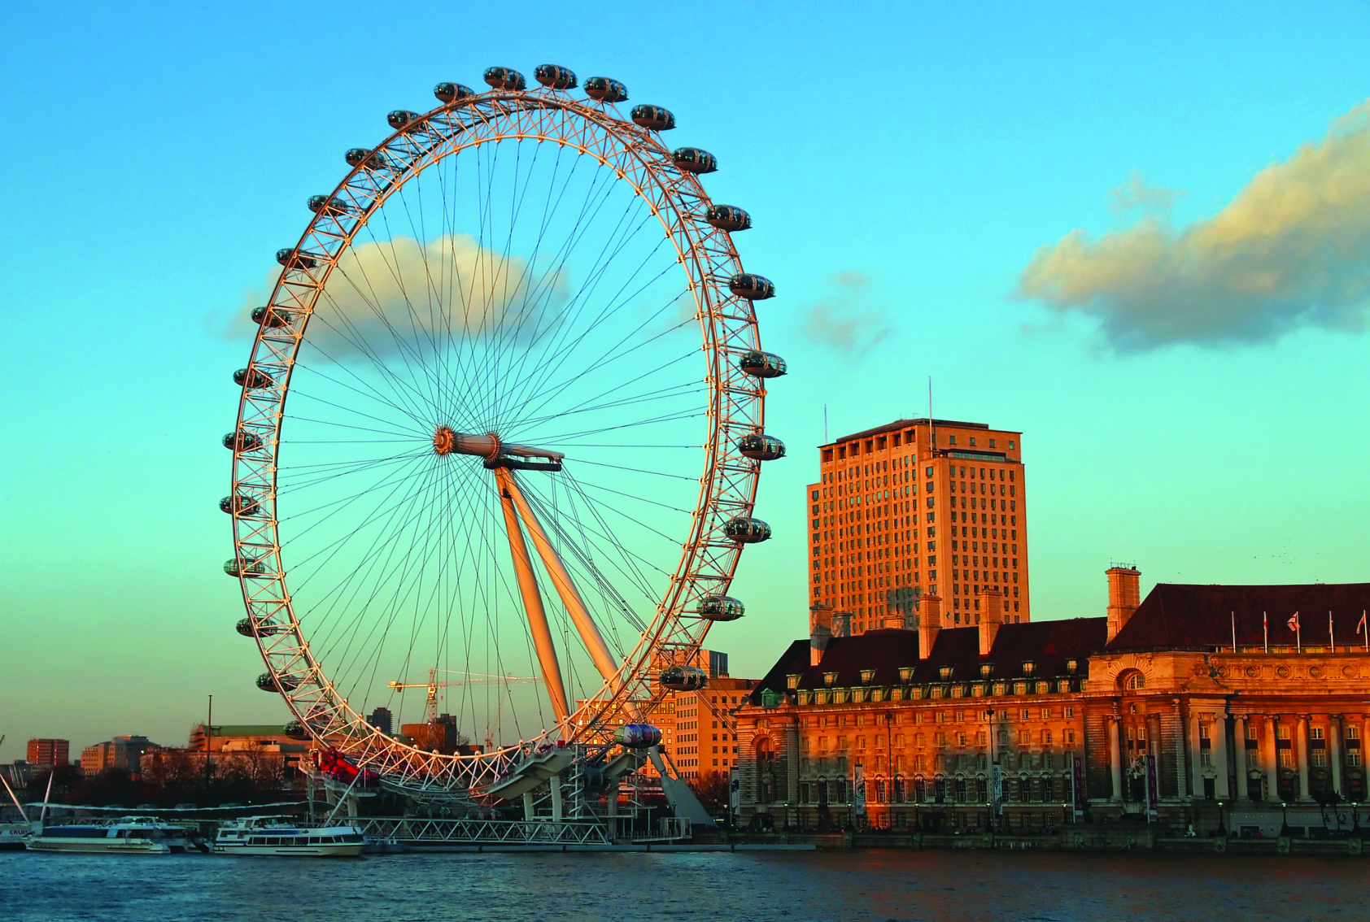
Call the Name of a giant observation wheel!

Slide 11
This bridge crosses the River Thames and became the iconic Symbol of London

Slide 12
How was used the Durham Cathedral in the cinema industry?

Slide 13
Make a Presentation of Great Britain

Slide 14
Please answer following questions!
What difficulties did you come across during the lesson?
Would you like to get the lessons in such form?
How can you characterize the lesson in one word?

Slide 15
Home task
Find information and prepare a report about places of interest in London
Find a video to the topic “Great Britain”, “Cities of Great Britain”

Slide 16
Thank you for your attention

