Slide 1
Shall We ?
Do Sports
We will:
Watch videos
Practise sports vocabulary
Read about an extreme sport
Speak about extreme sports

Slide 2
What sports are the children doing?

Slide 3
The children are …
snowboarding
skateboarding
doing gymnastics
surfing
playing basketball
water skiing
kickboxing
BMX biking
weight lifting
doing parkour
dancing
climbing
doing marshal ['mɑːʃ(ə)l] arts
playing football
diving
wrestling

Slide 4
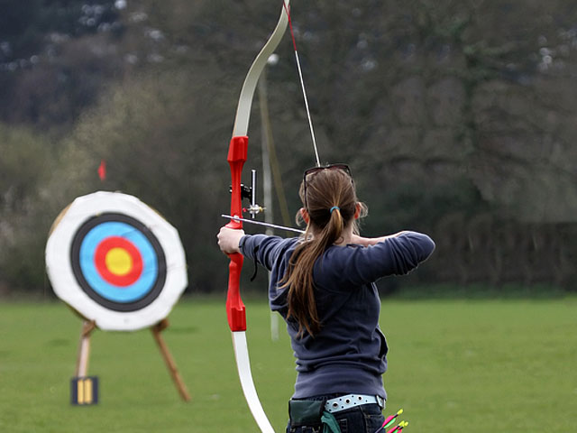
What sports equipment do we need for…?
__tennis
__baseball
__golf
__archery
__badminton
__football

Slide 5
Check the answers. We need…for…
2)
__for tennis
__ for baseball
__ for golf
__ for archery
__ for badminton
__ for football
4)
3)
1)
6)
5)

Slide 6
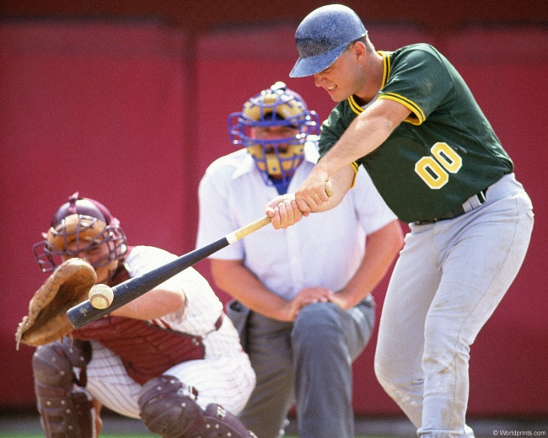
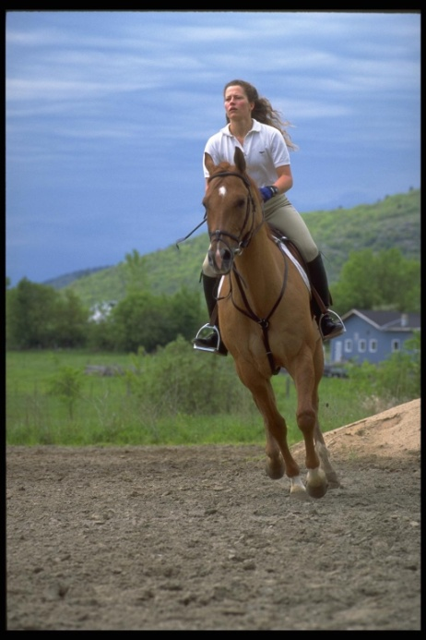
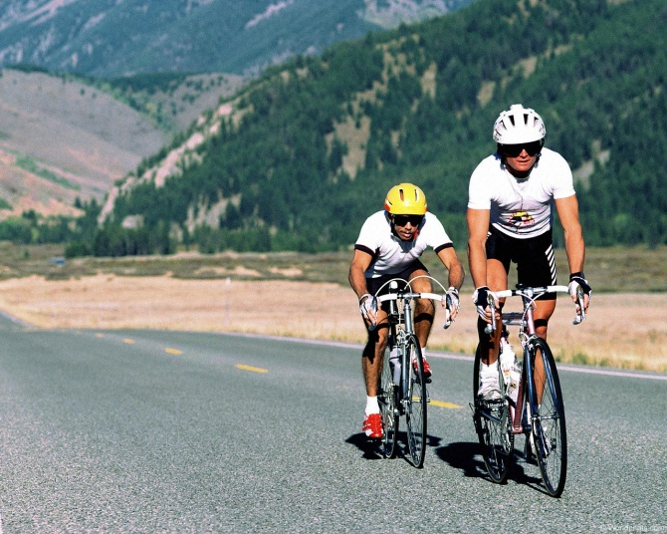
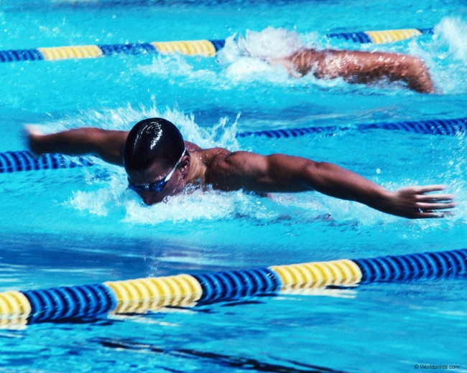
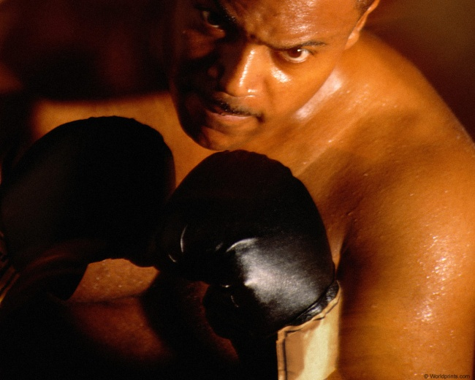
Listen to your groupmates’ projects Guess the sports

Slide 7
Whose project do you like best? Why?
I think
I suppose
To my mind
As for me
I should say
Ann’s project is the best because…
…it is informative/interesting
…it has great pictures
…I really like hose riding

Slide 8
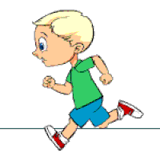
Running Dictation
Take turns to run to the text and back
Dictate three/four words from the text to your team mate
Mind your spelling
The winner is the team that finishes first

Slide 9
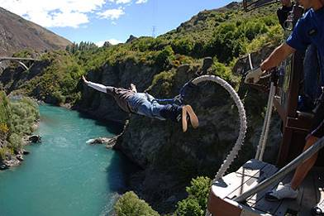
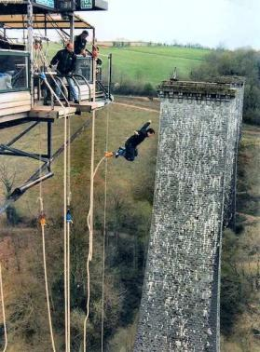
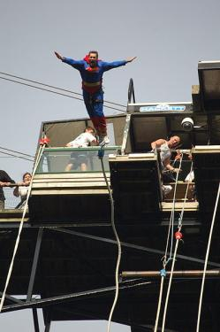
Bungee jumping

Slide 10
Pre-listening

Slide 11
Buzz and Bob’s big adventure Make it right!

Slide 12
Watch the video about Buzz and Bob

Slide 13
Check up. Five correct answers – a “5”, four correct answers – a “4”
rocks
scared
bats
surfing
Buzz saves Bob

Slide 14
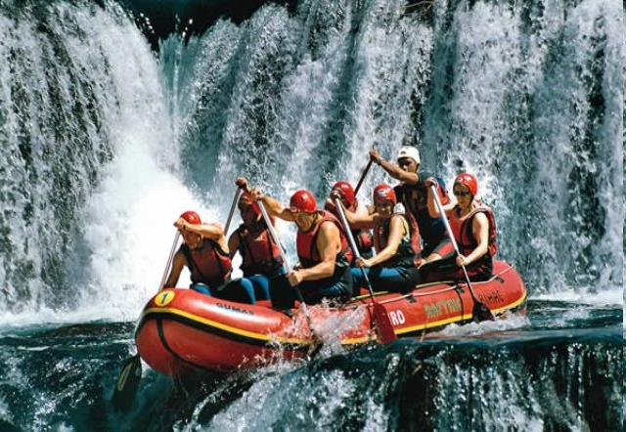
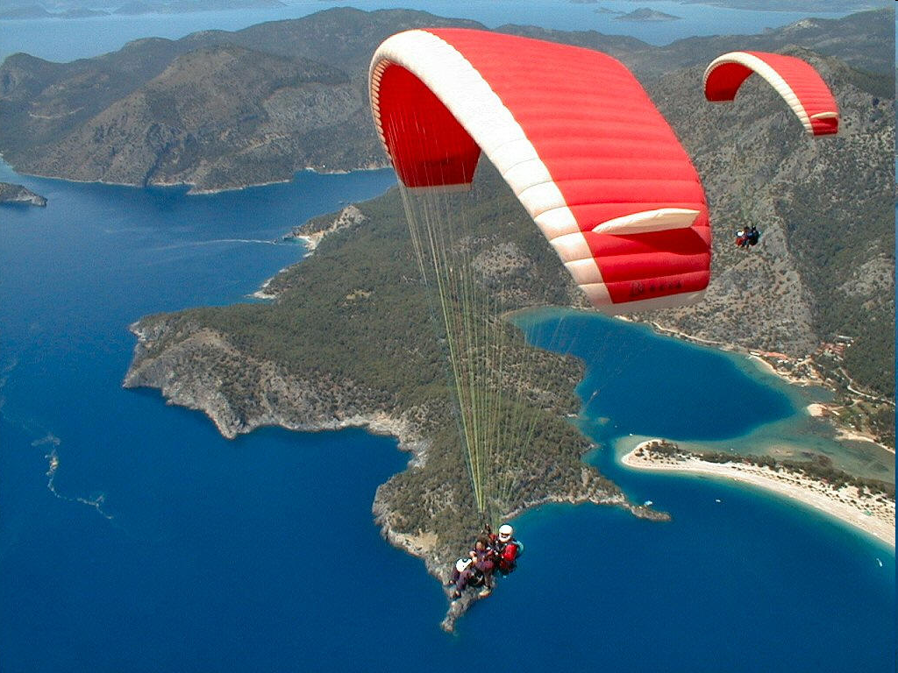
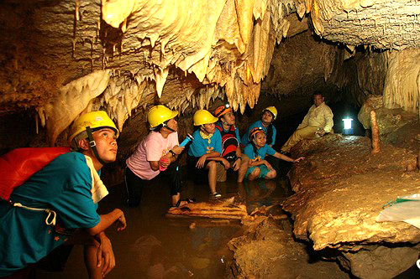
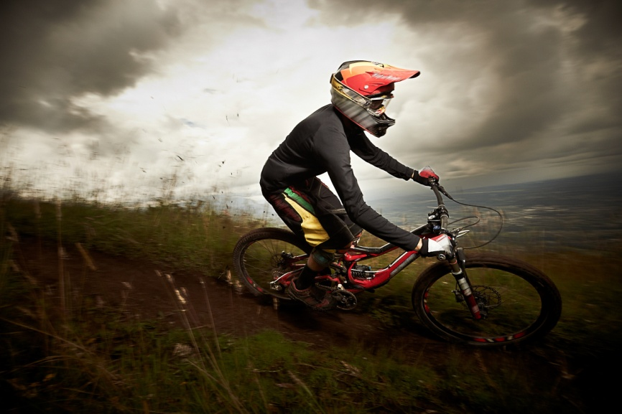
Role play the dialogue “Shall we …?”

Slide 15
What have you learnt at the lesson?
I knew that …
I have learnt at the lesson that…
It surprised me …

Slide 16
Home task
Choose any Extreme sport and make a Power Point presentation using a plan.
History
Equipment
Rules
How risky it is

Slide 17
Thank you!

