Slide 1
William Caxton
(1422-1491)
the first English printer, a translator and importer of books into England

Slide 2
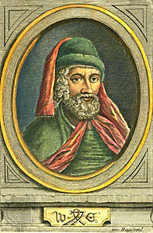
Glimpses of biography
born in Kent in 1422
at the age of 16 moved to London to become an apprentice to a merchant
1462 - 1470 - he served as governor of the 'English Nation of Merchant Adventurers'
1472 - set up a press in Bruges
1476 - established a press at Westminster
died in 1492

Slide 3
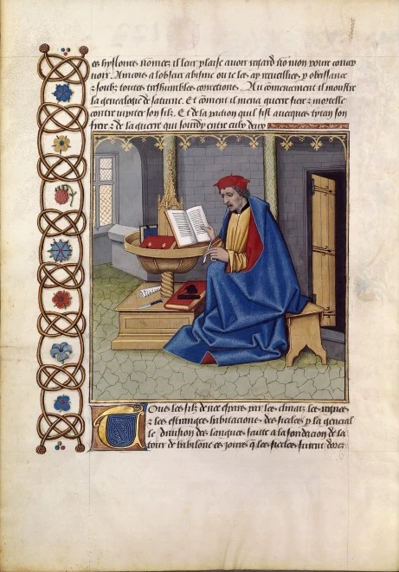
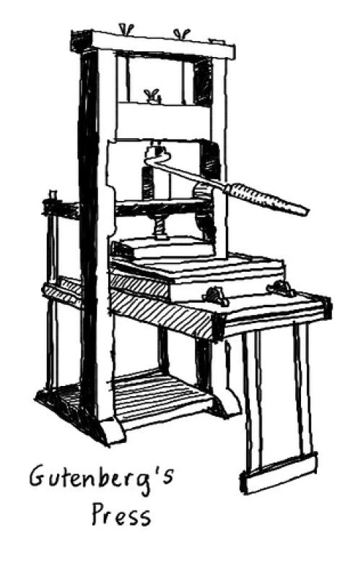
Turning to literature
The first full-scale book was printed in the 1450s by Johann Gutenberg in Mainz.
In March 1469 Caxton had begun to translate Raoul Le Fèvre's 'Recueil des histoires de Troye’ from French to English.
Cologne - the most important centre of printing by 1470s.
'The Recuyell of the Histories of Troye' (1475)

Slide 4
Translated and printed books
'The Recuyell of the Histories of Troye' (1475)
'The Game and Playe of the Chesse’ (1476)
Chaucer's 'Canterbury Tales'
Gower's 'Confession Amantis'
Malory's 'Le Morte d'Arthur'
Translations of the Golden Legend 1483) and The Book of the Knight in the Tower (1484) contain perhaps the earliest verses of the Bible to be printed in English.

Slide 5
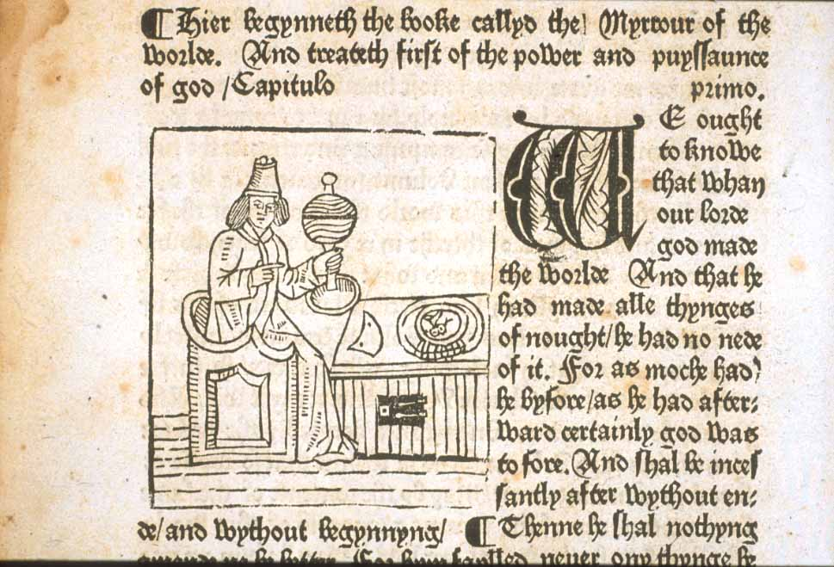
Books became available
Mostly books are produced in Latin
Caxton writes in English for a local market
Printing development led to cheaper price of books
People began to use books for information and entertainment

Slide 6
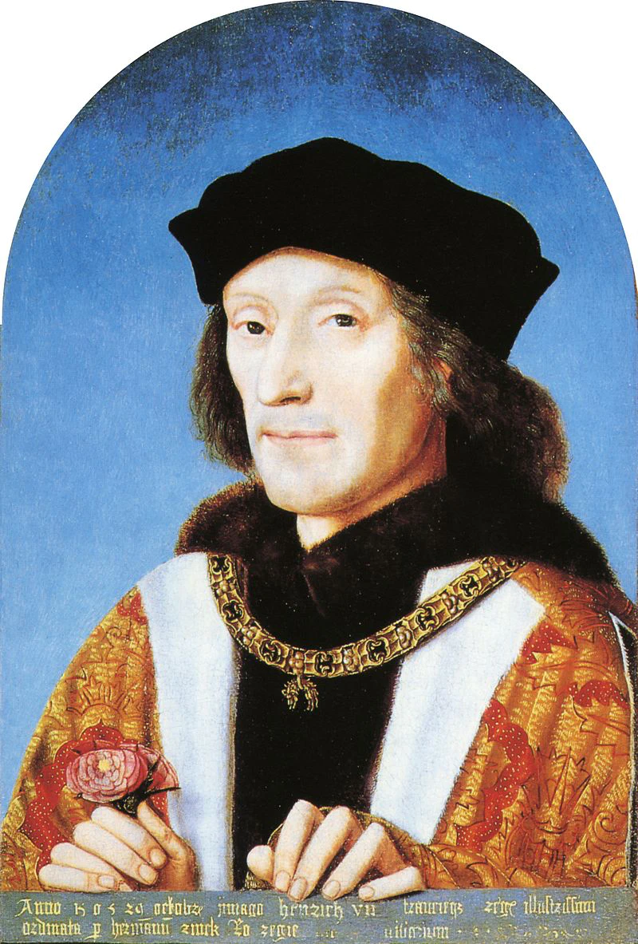
Position among Aristocracy
Printers had to keep in favour with the aristocracy
The second edition of the Canterbury Tales in 1483 and the death of Edward IV
Richard, Duke of Gloucester on the throne, Caxton wrote 'Ordre of Chyvalry or Knyghthode' dedicated to Richard III
Caxton was commissioned to print the parliamentary statutes passed under Henry VII
Henry VII

Slide 7
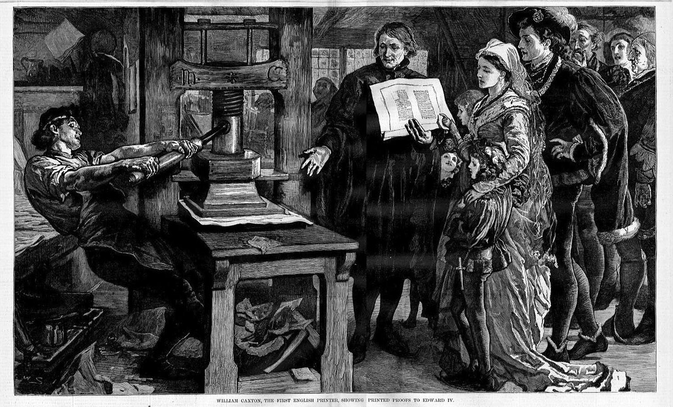
An impact on the English language
English was to become standard
Caxton adopted a special variety of Middle English ( 'King's English’ )
Dialects of the vernacular were marginalised and sometimes died out
Caxton introduced printing marks and facilitated the expansion of English vocabulary

