Slide 1
Crime. Types of crime. Causes of crime

Slide 2
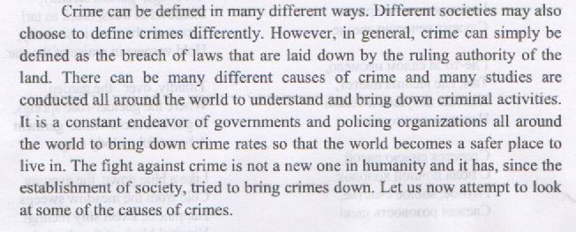
Crime

Slide 3
Additional Vocabulary
Murder (n) – убийство; (v) убивать.
Murderer – убийца (мужчина); murderess –убийца (женщина)
premeditated murder – преднамеренное убийство
Unpremeditated murder – непреднамеренное убийство
Gang murder – групповое убийство
Mass murder – массовое убийство
Attempted murder – попытка совершения убийства

Slide 4
Kill – убивать; killing – убийство; killer - убийца
Kill by contract – совершить заказное убийство
Contract killing – заказное убийство
Gang killing – групповое убийство
Mass killing –массовое убийство

Slide 5
Assassination - убийство по политическим мотивам
Assassinate – совершить убийство по политическим мотивам
Assassinate a leader
Assassin –убийца политического деятеля.

Slide 6
Hijack – похищать транспортное средство
Hijack (n) – похищение транспортного средства
Hijacker – похититель транспортного средства

Slide 7
Assault - нападение
Assault on somebody – нападение на кого-либо
Commit an assault – совершить нападение

Slide 8
Steal – воровать, грабить
Steal something from somebody’s household – украсть что-то из жилого помещения
Theft – воровство, кража
Rob – красть
Robbery – ограбление.

Slide 9
Types of crime
Murder - Unlawfully and deliberately killing someone
Kidnapping - Taking somebody by and demanding money or conditions to free that person

Slide 10
Burglary - To enter a building, often while no one is in it, and steal money or objects
Mugging - To take something by force from someone, often in the street

Slide 11
Pickpocketing - To steal from someone’s pocket, without them realizing
Arson - To set fire to abuilding illegally
Rape – To violently attack a person sexually.

Slide 12
Hijacking - To use force to take control of a plane, ship, train, etc.
Fraud - To deceive or cheat someone to get money
Theft - Stealing-usually secretly and without violence
Manslaughter- Killing someone by accident through a careless or dangerous act

Slide 13
Smuggling - To bring illegal goods, like drugs, into a country or to bring goods into a country without paying taxes.
Shoplifting - To steal things while pretending to shop

Slide 14
Causes of crime

Slide 15
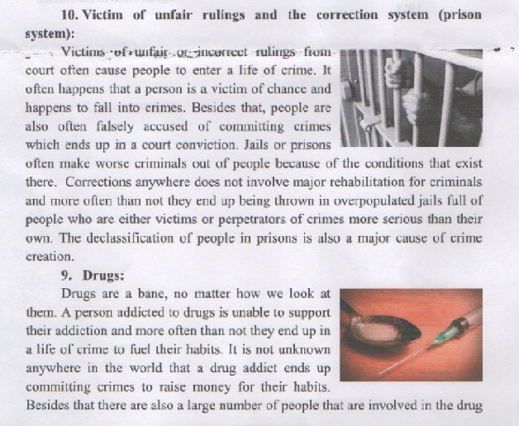

Slide 16
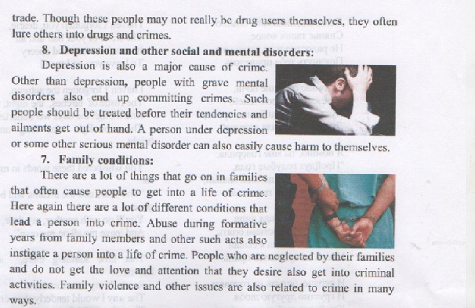

Slide 17
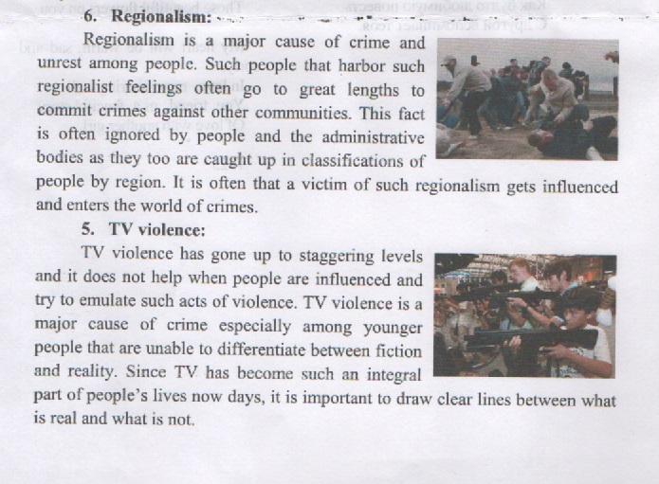

Slide 18
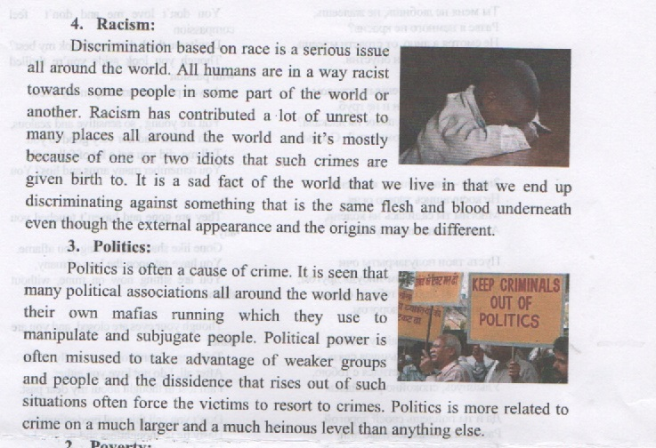

Slide 19
