Slide 1
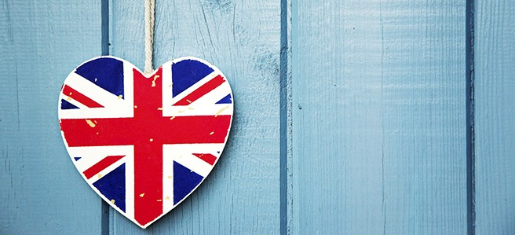
PRESENT SIMPLE vs PRESENT CONTINUOUS

Slide 2
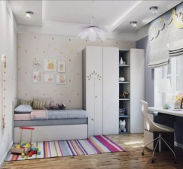
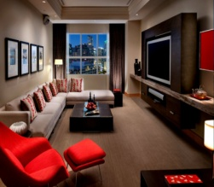
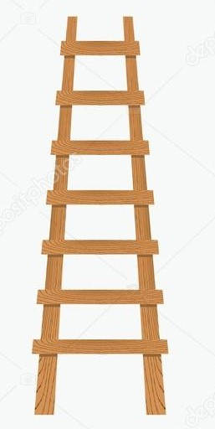
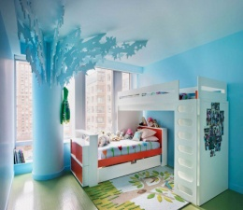
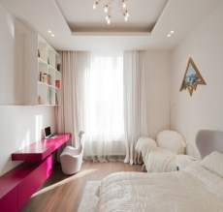
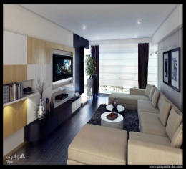
43 | 44….but always he…(dance). | 45…..but now we…busy | 46 I…(watch) TV now…. | 47 | 48…… but usually I(listen) to music/ | 49…but usually I(read)
42He…(sing) now | 41….but now I ….sad | 40He (get up) in the morning always… | 39 | 38…..but now he….(get up) in the afternoon | 37I like (paint ) every day | 36 I …(paint) now…
35We often (play)… | 34 | 33I like to( walk) usually….. | 32…..but now I …. fond of sports. | 31 | 30…..but I rarely (cook). | 29I…(cook) now..
28)I always (play) football meet my friends…. | 27He ….(do homework) now… | 26 | 25but he(play) football usually . | 24…but now she ….(rest). | 23 | 22Mom (work) every day…
15 | 16Father usually (work)here… | 17I (run) in the morning every day | 18……but now I…(do exercises) | 19…..but now I(not/read). | 20…..but I(not/listen) to music always. | 21…but now she …..(cook)
14I (go) to school every day….. | 13 | 12I …..(think) now. | 11…….but now I…. sick | 10 | 9 | 8Sister usually (do homework)….
1) …..but now he …. in a cafe. | 2)…….but now I……….busy. | 3 | 4I…..(listen) to music now | 5I (play) with the dog every day | 6I often (read) | 7…….but now mom…(play).

Slide 3
Игры, составленные детьми в качестве домашнего задания

Slide 4
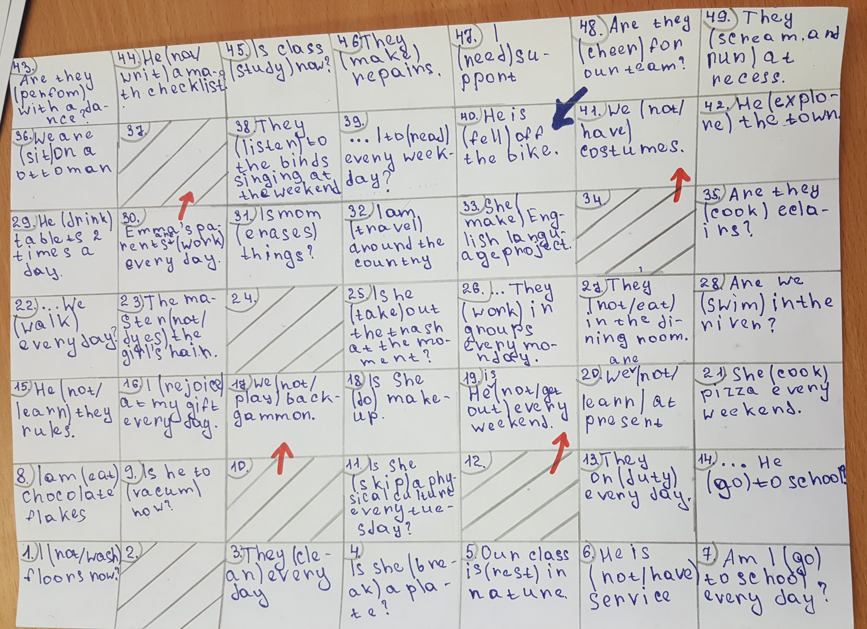

Slide 5
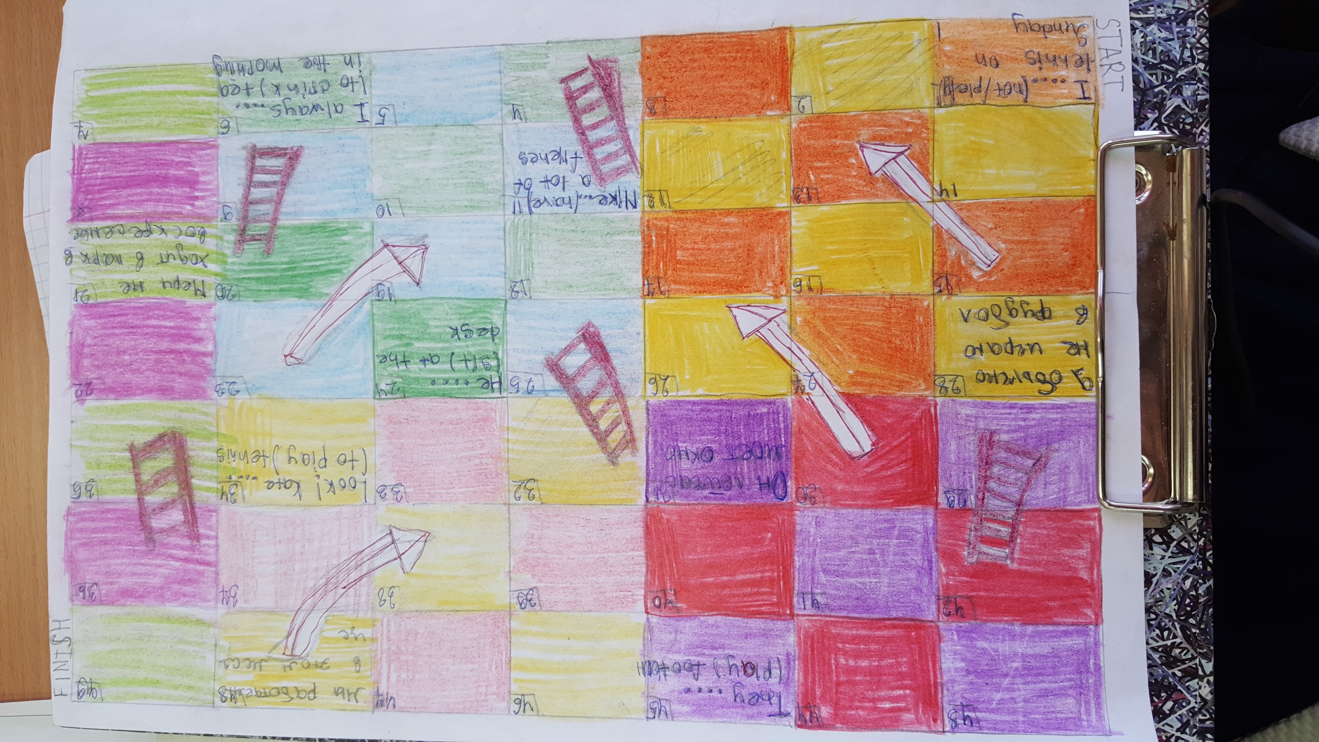
Мы работаем в это месяце
They … (play) football
Он сейчас моет окно
Look! Kate … (to play)
Я обычно не играю в футбол
He … (sit) at the desk.
Мэри не ходит в парк по воскресеньям
Mike … (have) a lot of friends
I always … (to drink) tea in the morning.
I … (not play) tennis on Sunday.

