Slide 1
Importance of reading books
Bestsellers in the USA and UK
Reading Techniques
Grades 10,8
Teacher : Tlep A.T

Slide 2
Lesson objectives:
1) to enlarge students’ knowledge about the importance of reading books
2) to introduce the bestsellers books and types of reading techniques
3) to involve students for reading pleasure.

Slide 3
Importance of Reading books Reading is important because it develops our thoughts , gives us endless knowledge and lessons while keeping our minds active . Books can hold and keep all kinds of information , stories , thoughts and feeling unlike anything else in this world.

Slide 5
Types of reading techniques
Skimming is sometimes referred to as gist reading.
Scanning involves getting just a simple piece of information.
Intensive reading has indeed beneficial to language learners as it
helps them understand vocabulary by deducing the meaning of
words in context.
Extensive reading involves reading for pleasure

Slide 6
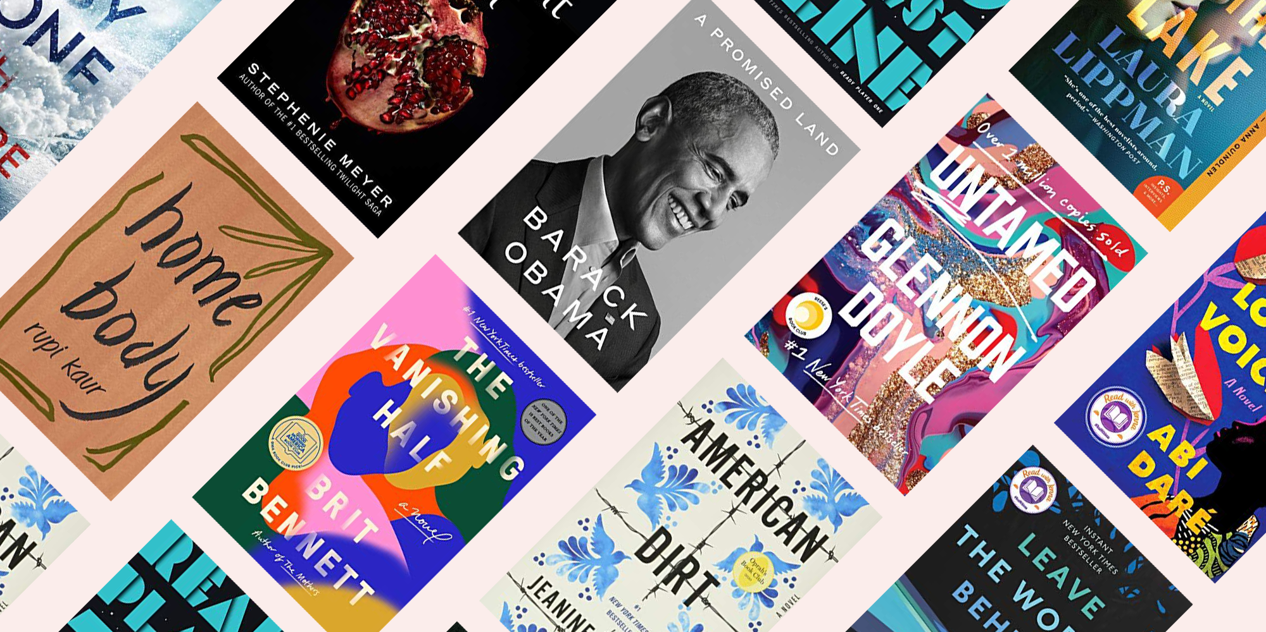
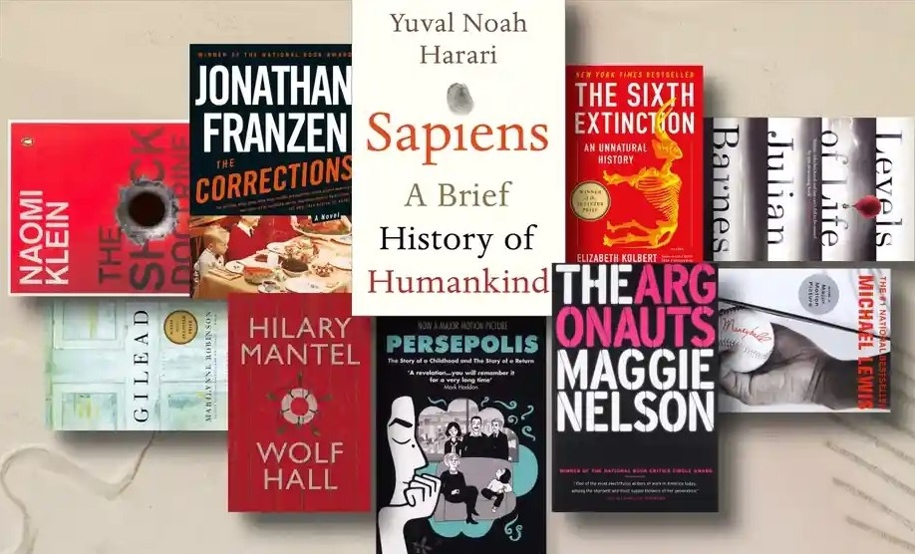
Bestsellers in the USA and UK

Slide 7
English bookshop
Harry Potter
The Boy , The mole ,The Fox and the Horse
The very hungry Caterpillar
The pride and prejudice
The lord of the rings
The picture of Dorian gray
Sherlock holms
Oliver twist
Frankenstein
Treasure island

Slide 8
American bookshop
Dog man crime and punishment
Gone with the wind
When you trap a tiger
Angels and demons
Catching fire
Goodnight moon
Twilight
The dark tower
Who moved my cheese?
Moby dick

Slide 9
twilight
Twilight Saga- is a series of four vampire romance novels, written by American author Stephenie Meyer. Released annually from 2005 through 2008, the four books chart the later teen years of Isabella "Bella" Swan, a girl who moves to Forks, Washington, from Arizona and falls in love with a 104-year-old vampire named Edward Cullen. Since the release of the first novel, Twilight, in 2005, the books have gained immense popularity the world. The series is most popular among young adults; the four books have won multiple awards, most notably the 2008 British Book Award for "Children's Book of the Year" for Breaking Dawn while the series as a whole won the 2009 Kids' Choice Award for Favorite Book. In November 2011, the series had sold over 120 million copies worldwide with translations into at least 38 different languages around the globe.

Slide 10
Angels and demons
Angels and Demons ”is a 2000 novel by the American writer Dan Brown. The book is an adventure novel with elements of both a thriller and an intellectual detective story. Most of the events take place in Rome over the course of one day. The book was filmed in 2009.

Slide 11
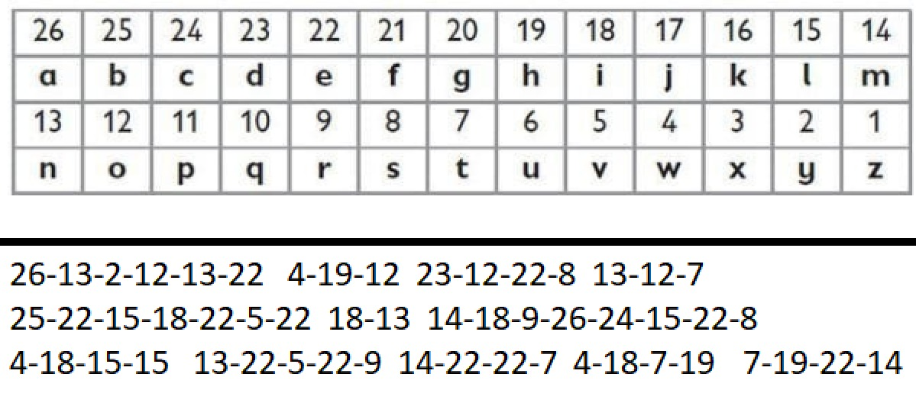
Break the code

Slide 12
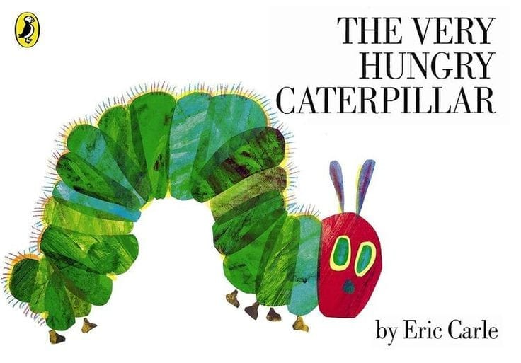
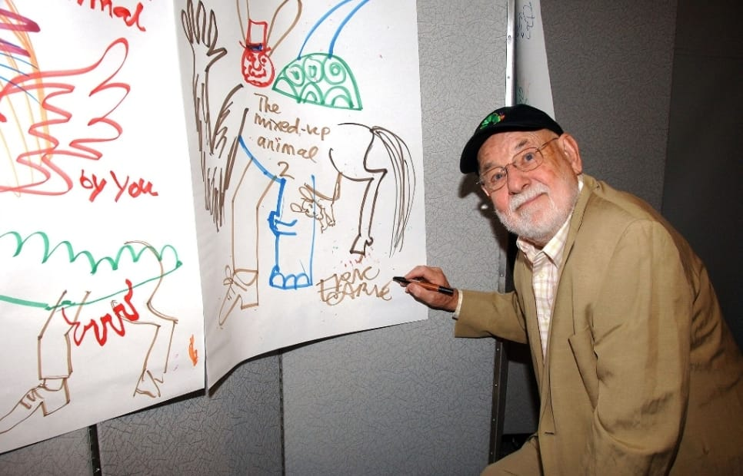
The Very Hungry Caterpillar is a children's picture book by the American writer Eric Karl. Released in 1969, subsequently reprinted many times. The text of the book presents the story of the caterpillar before it turned into a butterfly. The book has gained immense popularity in the English-speaking world, has won many awards and has been translated into more than 50 languages. Eric Karl is an American designer, illustrator and writer, author of The Very Hungry Caterpillar, a children's picture book.

Slide 13
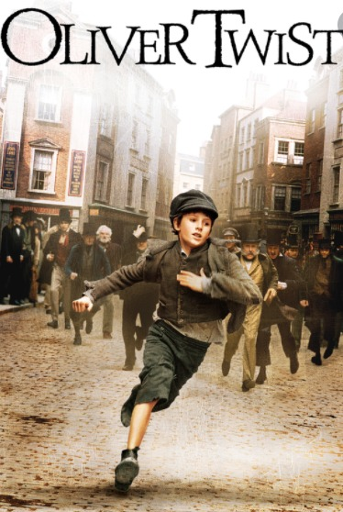
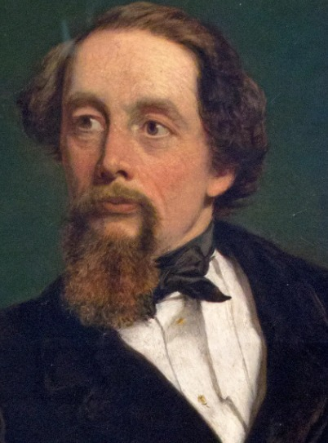
The book I would like to recommend to you is Oliver Twist . "Oliver Twist" is one of the famous 19th century British writer Charles Dickens's best-known works.He is British writer and critic in the mid-19th century. He was born in 1812 and died in 1870. More than a century after his death , "The little Dorrit" "Nicholas Nickleby" and "Oliver twist" These are still his classic works， striking is his body of work that is gave rise to it's own adjectives, Dickens's fiction brims with anticipation through settings plot twists and mysteries.The book "Oliver Twist" was released in 1838.Oliver twist deals with the plight of children in the care of the state , illustrating the brutal conditions of the workhouse in which Oliver pleads with Mr. Bunble for food , and when he flees to London he becomes ensnared in a criminal underworld, these stories frequently portray Victorian life as grimy corrupt and cruel.The story is about Oliver was an illegitimate child. His mother died after giving birth to him, and then described his tragic fate in detail. He was sent to the coffin shop as an apprentice when he was nine. He escaped and started his wandering life.

Slide 15
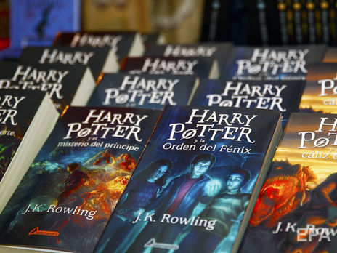
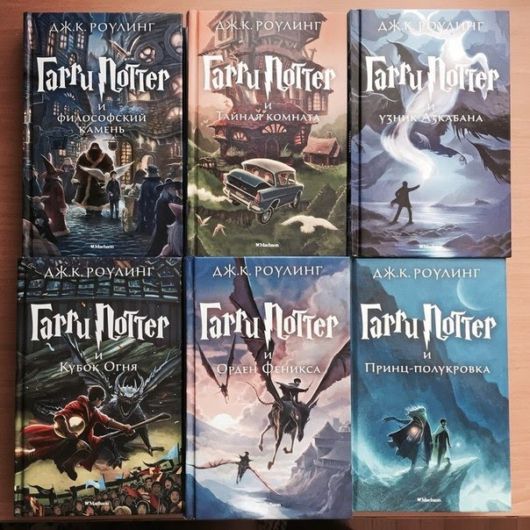
A series of novels by British writer J.K. Rowling. The books chronicle the adventures of the young wizard Harry Potter, as well as his friends Ron Weasley and Hermione Granger, who study at the Hogwarts School of Witchcraft and Wizardry. The main plot is devoted to the confrontation between Harry and a dark wizard named Lord Voldemort, whose goals include gaining immortality and enslaving the wizarding world. Beginning with the publication of the first novel, Harry Potter and the Sorcerer's Stone, on June 26, 1997, the series has gained popularity, critical acclaim and commercial success worldwide [As of February 2018, the number of books sold was about 500 million copies, as a result of which the series entered the list of literary bestsellers. The novels have been translated into 80 languages, including Russian [2] [3]. The last four books have consistently set records as the fastest-selling literary work in history. The series is a combination of many genres, including fantasy and adolescent novel with elements of adventure, detective, thriller and romance novel, and also includes many cultural references [4] [ 5] [6] [7].Death is the main theme of the novels, according to Rowling, [8] although they are viewed primarily as children's literature. In addition, the series covers topics such as prejudice and corruption.The main part of the Harry Potter series is a set of seven books about the battle with the dark wizard Voldemort and his minions. In the seventh and final book, the training is no longer - it is entirely devoted to preparing Harry and his friends for the final battle with Voldemort and this battle itself.

Slide 17
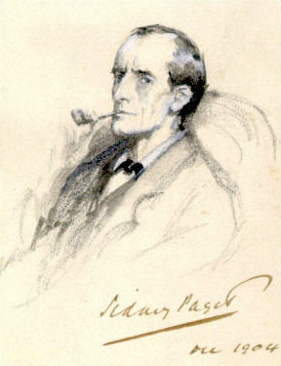
Sherlock holmes
Sherlock Holmes is a fictional private detective created by British author Sir Arthur Conan Doyle. Referring to himself as a "consulting detective" in the stories, Holmes is known for his proficiency with observation, deduction, forensic science, and logical reasoning that borders on the fantastic, which he employs when investigating cases for a wide variety of clients, including Scotland Yard.First appearing in print in 1887's A Study in Scarlet, the character's popularity became widespread with the first series of short stories in The Strand Magazine, beginning with "A Scandal in Bohemia" in 1891; additional tales appeared from then until 1927, eventually totalling four novels and 56 short stories. All but one are set in the Victorian or Edwardian eras, between about 1880 and 1914. Most are narrated by the character of Holmes's friend and biographer Dr. John H. Watson, who usually accompanies Holmes during his investigations and often shares quarters with him at the address of 221B Baker Street, London, where many of the stories begin.

Slide 18
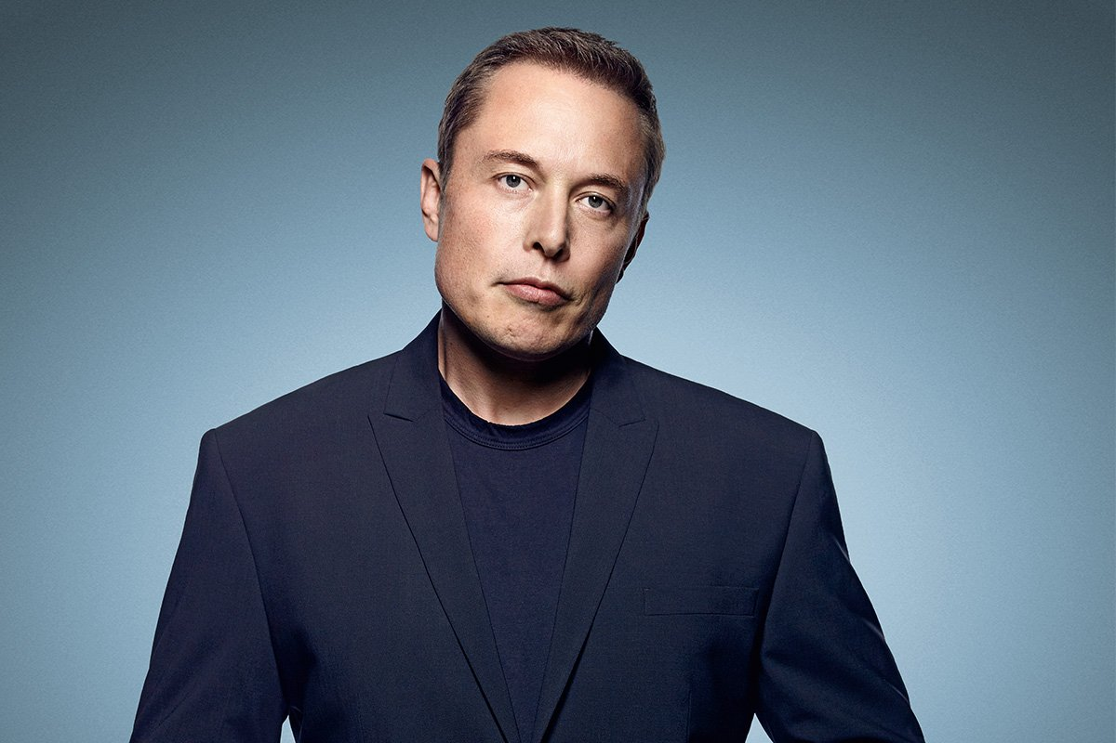
Jordan Bernt Peterson (born June 12, 1962) is a Canadian clinical psychologist and professor of psychology at the University of Toronto.
Elon Reeve Musk [* 1] (English Elon Reeve Musk, born June 28, 1971 [ Pretoria, South Africa) - American entrepreneur, engineer and billionaire.

Slide 19
interview with Jordan Peterson and Elon Musk

Slide 20
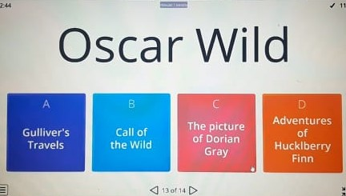
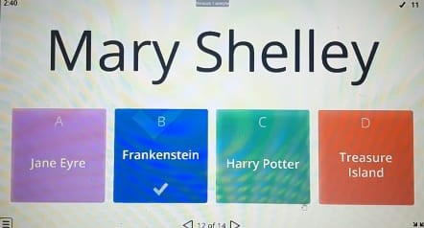
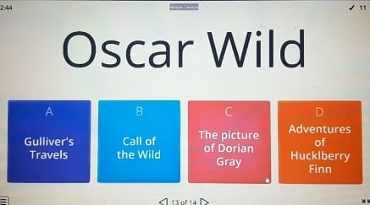
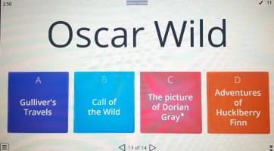
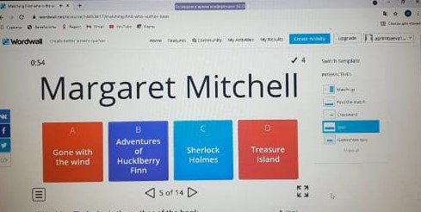
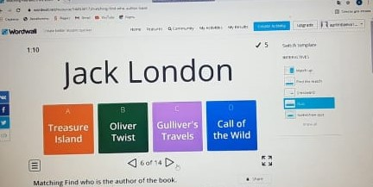
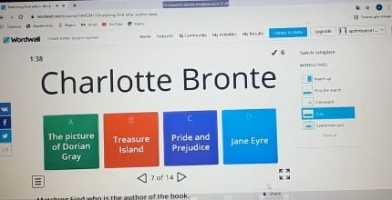
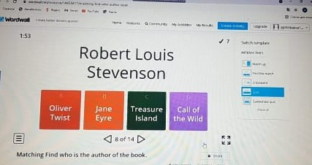
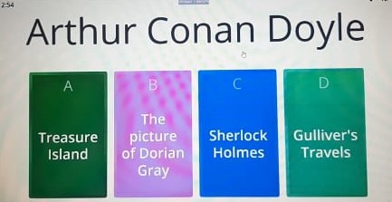
Game

