Slide 1
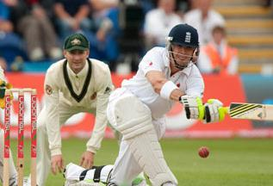
A popular British sport Criсket

Slide 2
Cricket appeared in the XVI century in the South of England. By the end of the XVIII century the game became the national sport .The first test matches between national teams were held in the middle of the XIX century .

Slide 3
A cricket match is a competition between two teams, each consisting of eleven athletes. The game takes place on a grassy field in the shape of a circle .

Slide 4
In the centre of the field there is a rectangular platform — the pitch. The length of the pitch is 22 yards or just 20 meters. At the end of the pitch there are wooden wickets. Play areas at the ends of the pitch are separated from the main space by special stripes.

Slide 5
Teams take turns striking the ball and play in the field, trying to score the maximum points or to prevent the opponent from doing it . In cricket there are two main players: the bowler and batsman who reflects the ball bat . The periods in cricket are called innings.

Slide 6
The innings continue until the batting team will not be taken out of the play, then the teams change their roles. The bowlers change after six innings, the set of which is called over.

Slide 7
Short games include only 20 overs. They last for 4 hours . Long games can last for 5 days, 6 hours a day.

Slide 8
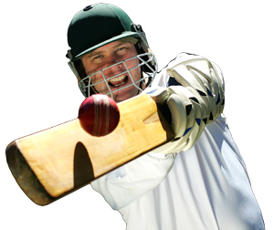
The rules of the game are created and modified by the Marylebone cricket club .

Slide 9
Cricket is a very interesting game.

