Slide 1
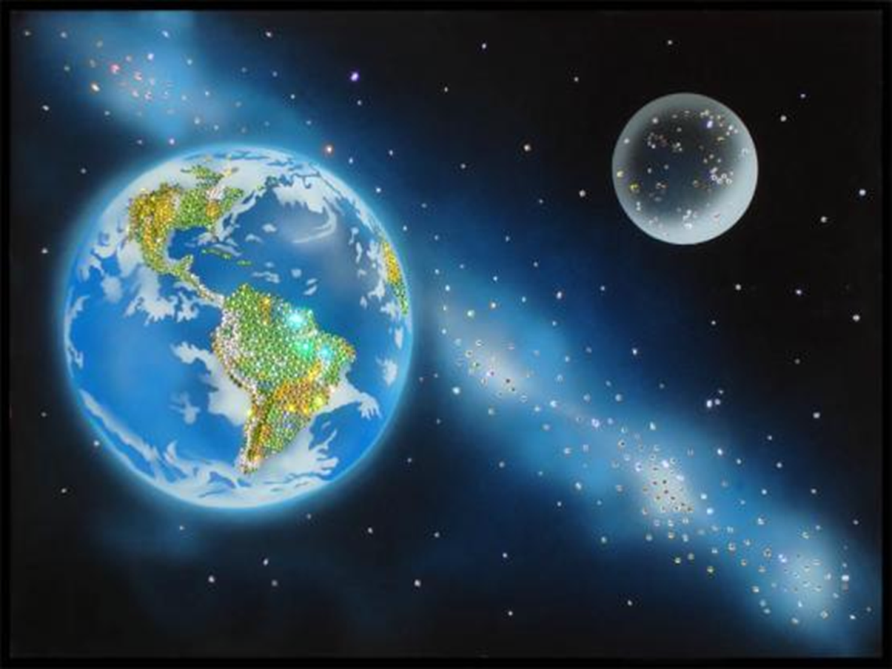
Do we need space exploration?

Slide 2
Konstantin Tsiolkovsky

Slide 3
Alexei Leonov

Slide 4
Valentina Tereshkova

Slide 5
Yuri Gagarin

Slide 6
Neil Armstrong

Slide 7
Sergei Korolev

Slide 8
Find the same words in Russian:
исследовать, изучать
конструировать
исследование
космический корабль
спутник
астронавт
исследователь
запускать
Astronaut
To construct
Exploration
To explore
A researcher
Launch
Spaceship
Satellite

Slide 9
Fill in the gaps with the following words: launched, planets, spaceship, cosmonaut, satellite, explored, research.
The____ flew at the speed of 300 miles a minute.
Yuri Gagarin was the first___ in the world.
The government spends money on scientific____.
I saw ____ and began to move towards it.
They’ve ____ their own solar system.
The Earth is the fifth largest of the nine main ___ in the solar system.
The satellite was ____ into space three days ago.

Slide 10
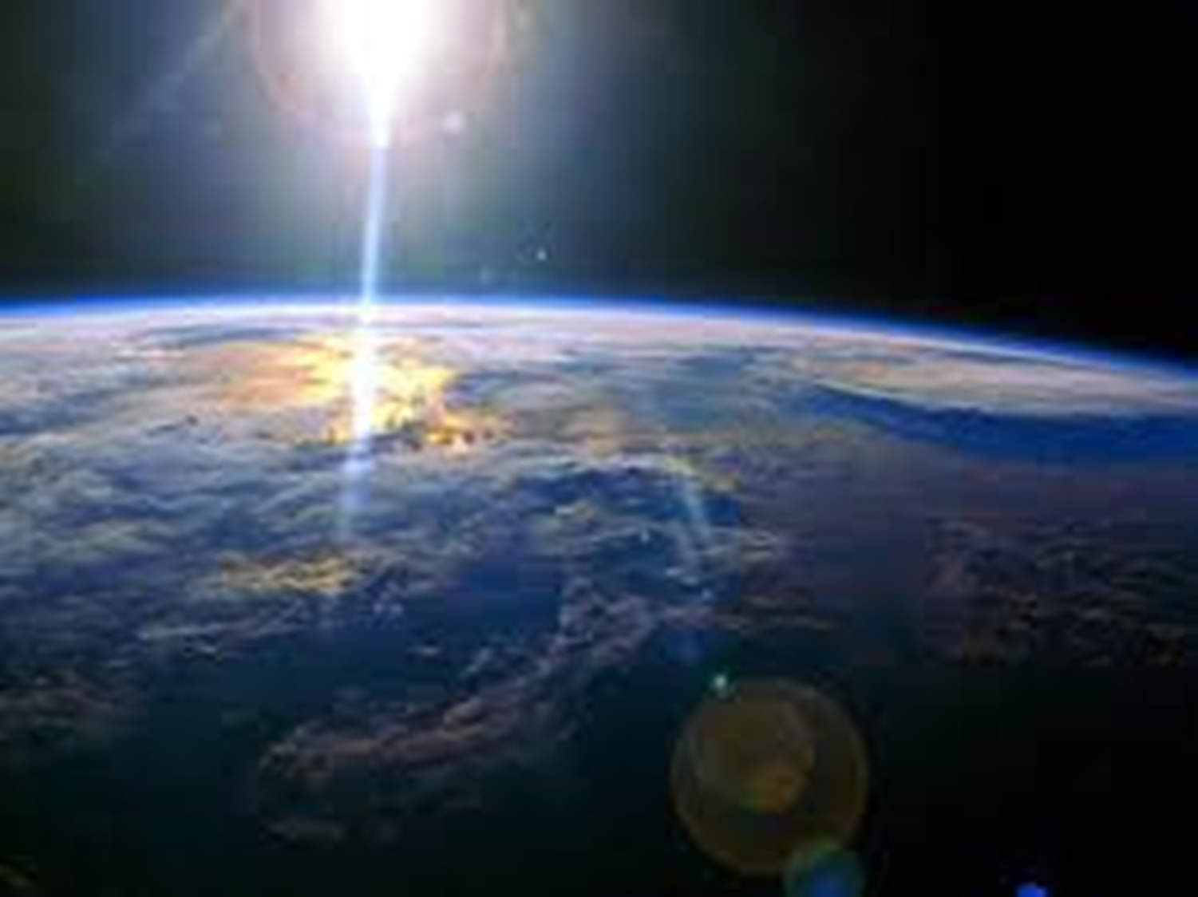

Slide 11
Why does the country spend much money on space research?
Why does Felix think that the situation is serious?
Linda thinks that people don’t take care of nature, doesn’t she?
Is it easy to ruin our planet and to find another planet for people in space?

Slide 12
Today at the lesson :
I have learned about…
I have read…
… was interesting for me
… was difficult for me

