Slide 1
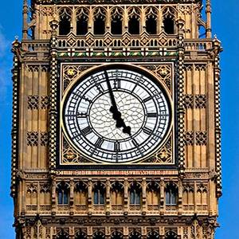
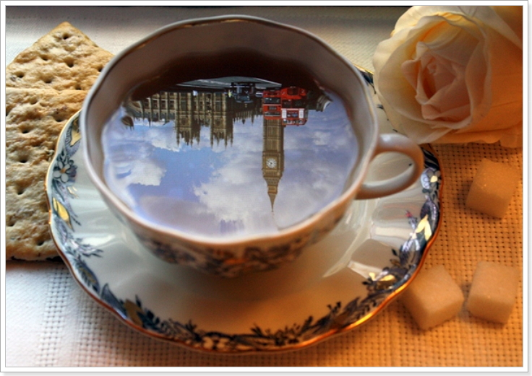
5 o’clock tea
Стебенева Светлана Альбертовна, преподаватель ГБПОУ МТК

Slide 2
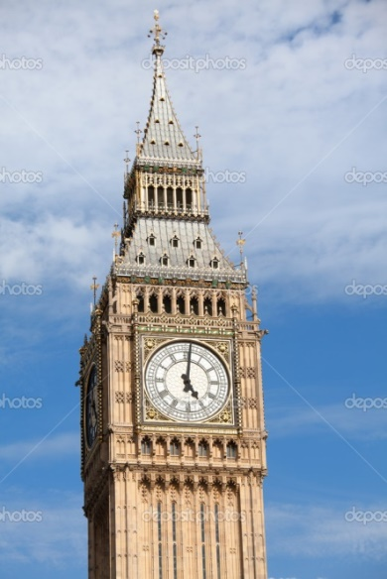
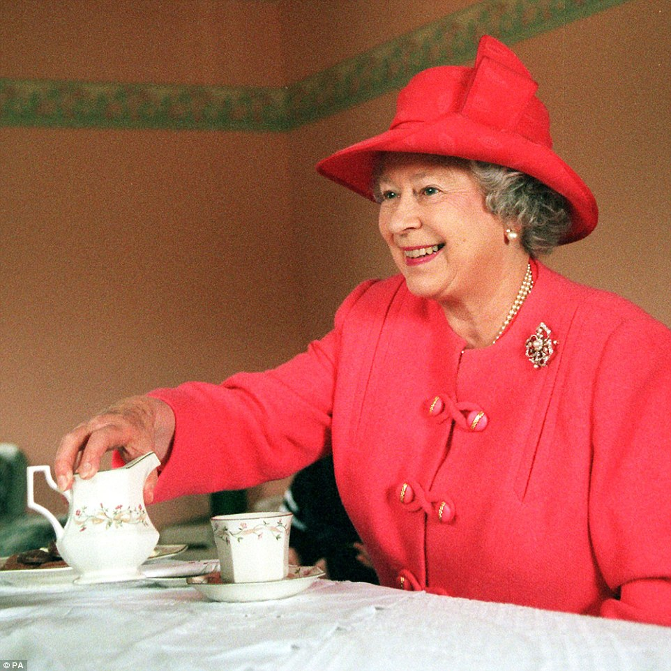
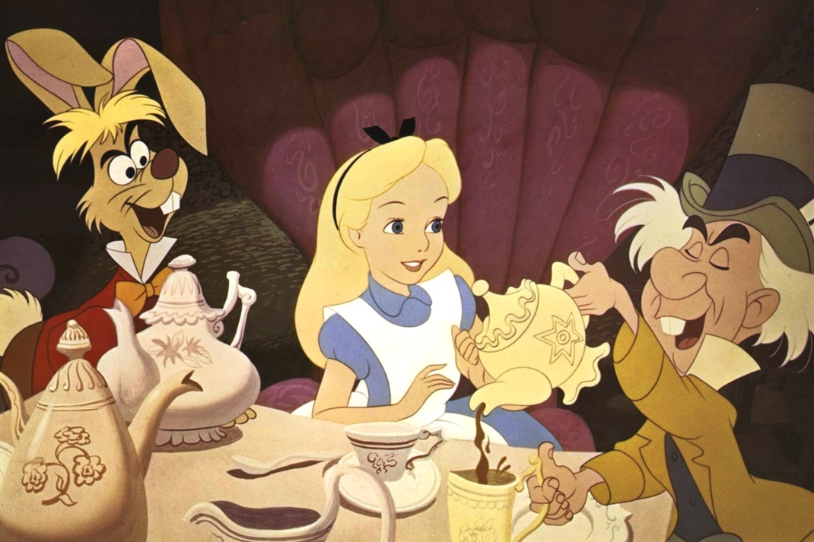
«Легче представить Британию без Королевы, чем без чая» , - шутят англичане.
Queen Elizabeth II
Alice In Wonderland

Slide 3
Useful words to remember:
Table appointments - сервировка стола
Cloth – скатерть
Napkins — салфетки
Serviettes - бумажные салфетки
Saucer – блюдце
Teaspoon – чайная ложка
Strainer – ситечко
Teapot – чайник для заварки чая
Plate — тарелка
Tea — чай
Cakes — пироги
Biscuits — печенье
Fruits — фрукты
Sweets – сладости, конфеты
Jam – варенье
Sugar — сахар
Milk – молоко
Scones – британские лепешки
Finger sandwiches – бутерброд (канапе)

Slide 4
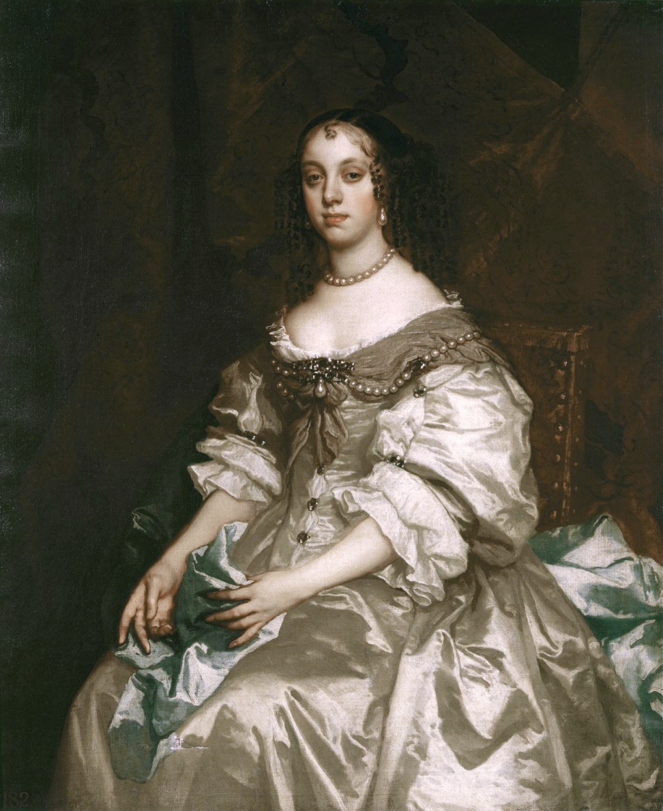
Why do Englishmen drink tea at exactly this time of the day?
Afternoon tea, that most quintessential of English customs is, a relatively new tradition. While the custom of drinking tea dates back to the third millennium BC in China and was popularised in England during the 1660s by King Charles II and his wife, it was not until the mid 19th century that the concept of afternoon tea first appeared.
Catherine of Braganza, wife of King Charles II of England

Slide 5
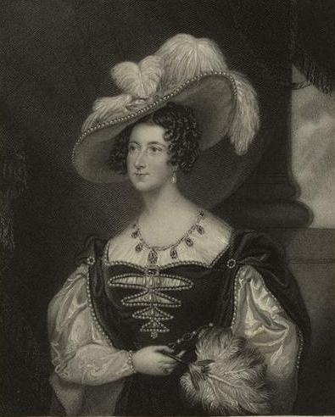
The History of the distinctive English tradition
Anna, the seventh Duchess of Bedford
Afternoon tea was introduced in England by Anna, the seventh Duchess of Bedford, who was the maid of honor of Queen Victoria, in the year 1840. The Duchess usually became hungry around four o'clock in the afternoon. The evening meal was served late at eight o'clock, thus leaving a long period of time between lunch and dinner. The Duchess asked to bring a tray of tea, bread and butter and cake to her room during the late afternoon. This became a habit of hers and she began inviting friends to join her.
This pause for tea became a fashionable social event.

Slide 6
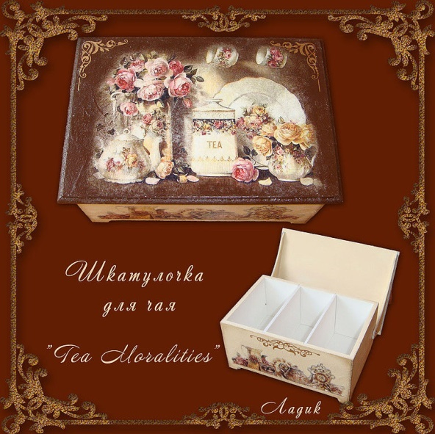
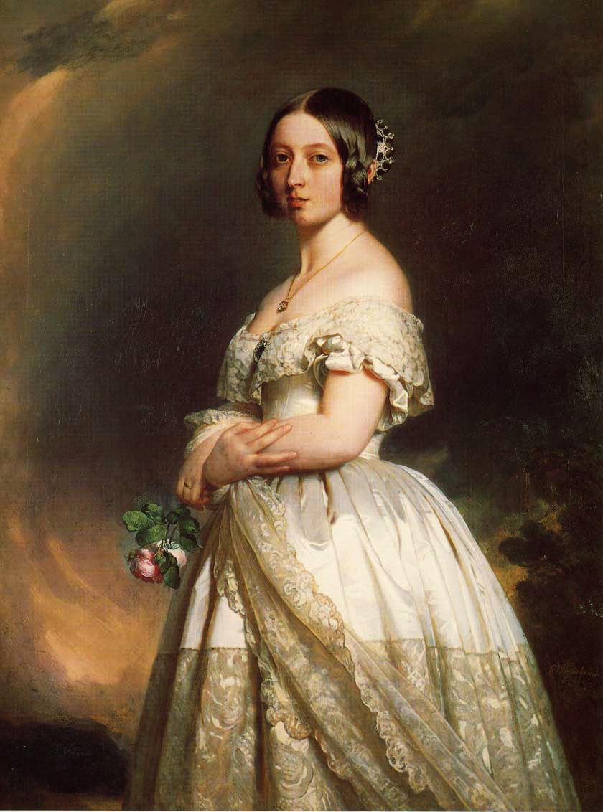
Tea Moralities
At the end of the XIX century Queen Victoria wrote a book on tea etiquette “Tea Moralities”, which is known to every true tea connoisseur.
Queen Victoria

Slide 7
Правила чайного этикета «Tea Moralities»
Блестящему перу королевы принадлежит сочинение «Tea Moralities», собственноручно ею написанные правила чайного этикета. Эти правила серьезно повлияли на современный чайный этикет и легли в основу европейских традиций делового общения. Вот некоторые из этих правил.
1. You must lay sugar in the tea carefully.
2. You must eat the pie with the help of spoon but not hands.
3. You mustn’t tap the spoon for a cup stirring tea.
4. During drinking tea Englishmen speak only about pleasant things.

Slide 8
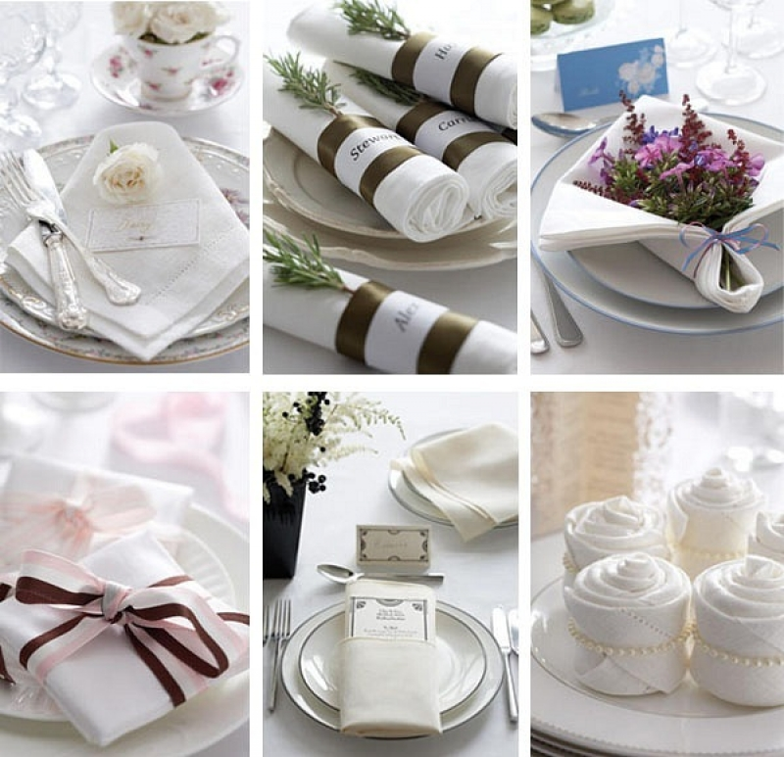
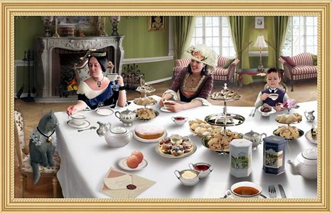
Table appointments
Serviettes
One-color table cloth. White or blue (better white).

Slide 9
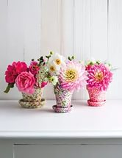
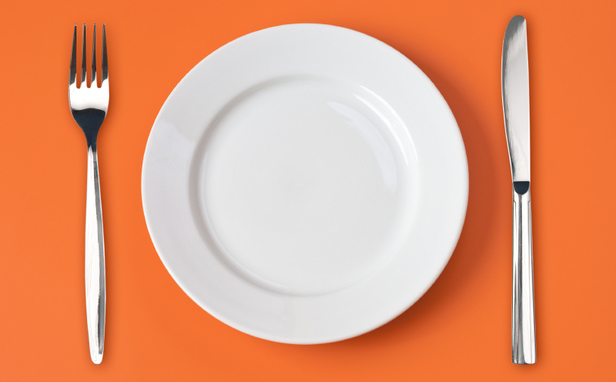
Table appointments
A small vase with flowers.
A fork and a knife for every tea-drinking person.

Slide 10
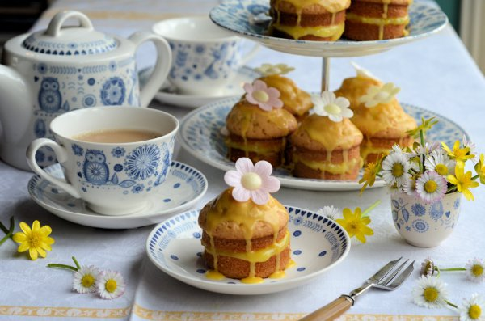
A tea cup and a saucer, the teapot with tea (either one for all or individual), a jug with boiled water, a jug with milk or cream. All plates and dishes, of course, must belong to one set. China set. White or blue and white.

Slide 11
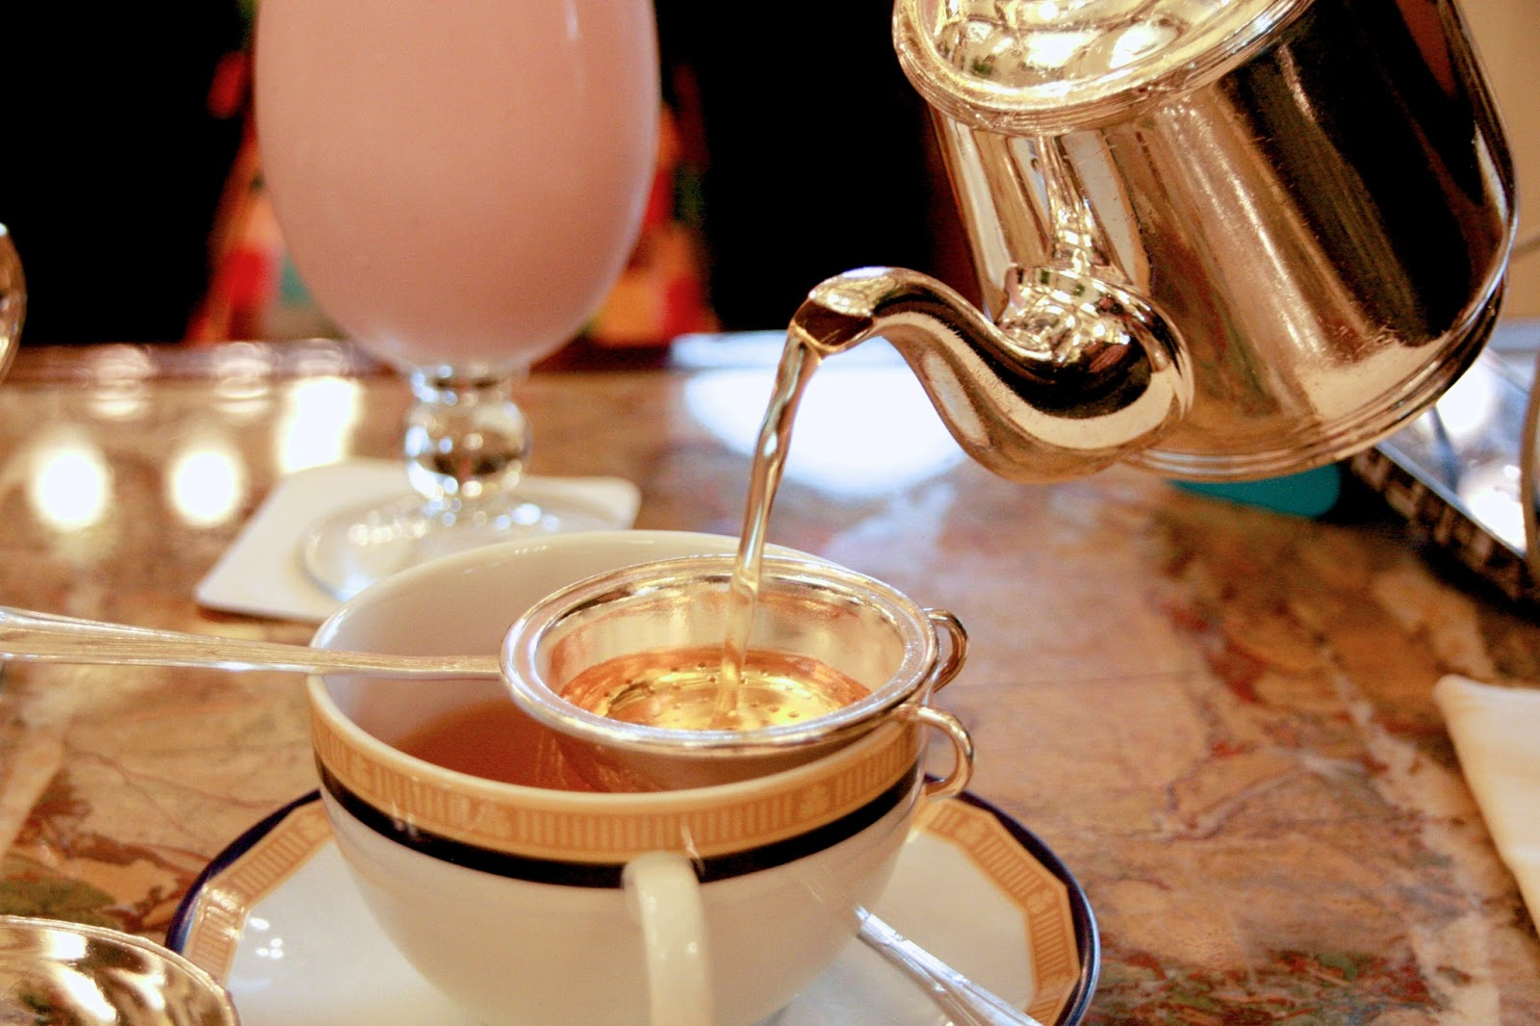
A tea strainer

Slide 12
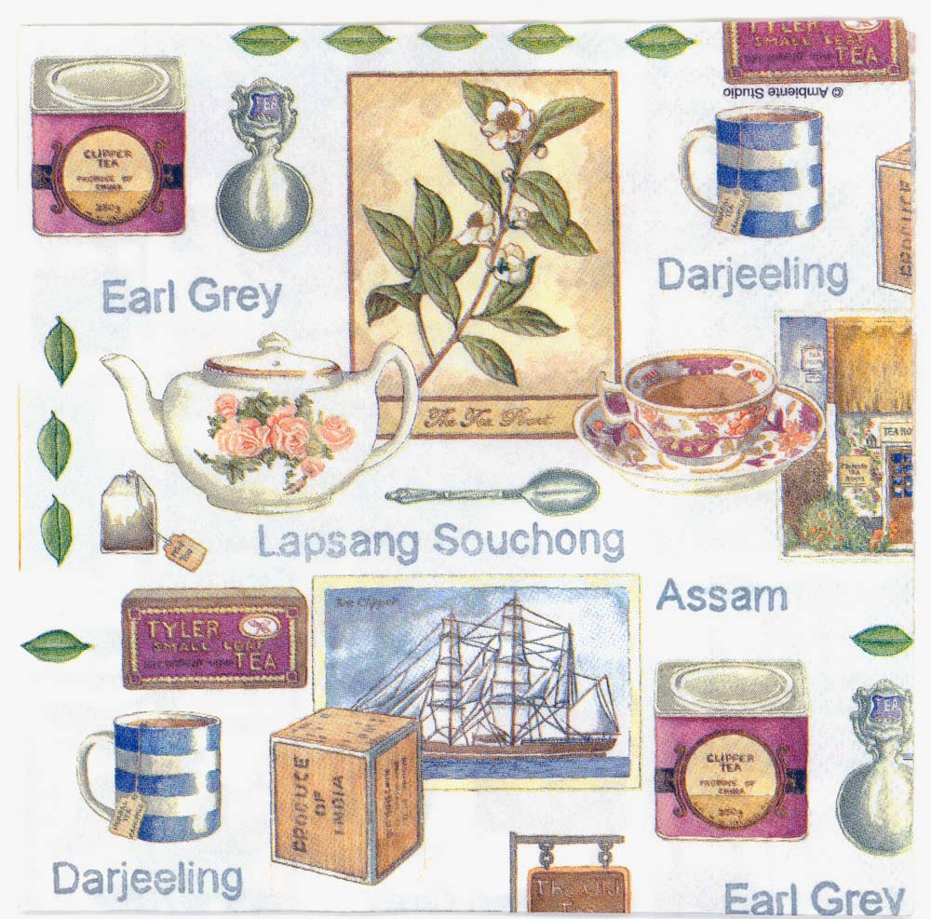
Tea
Usually, guests are offered 5 to 10 kinds of tea. Among which without fail there will be Earl Grey, Lapsang Souchong, Assam, and Darjeeling.

Slide 13
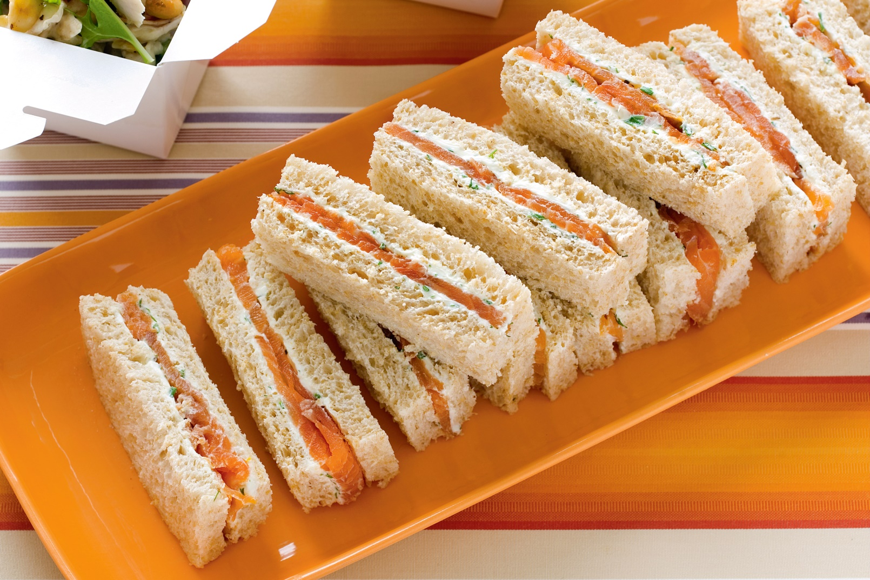
Traditional afternoon tea consists of a variety of sandwiches (thinly sliced cucumber sandwiches (finger sandwiches), and various cakes and buns (scones).
Finger sandwiches

Slide 14
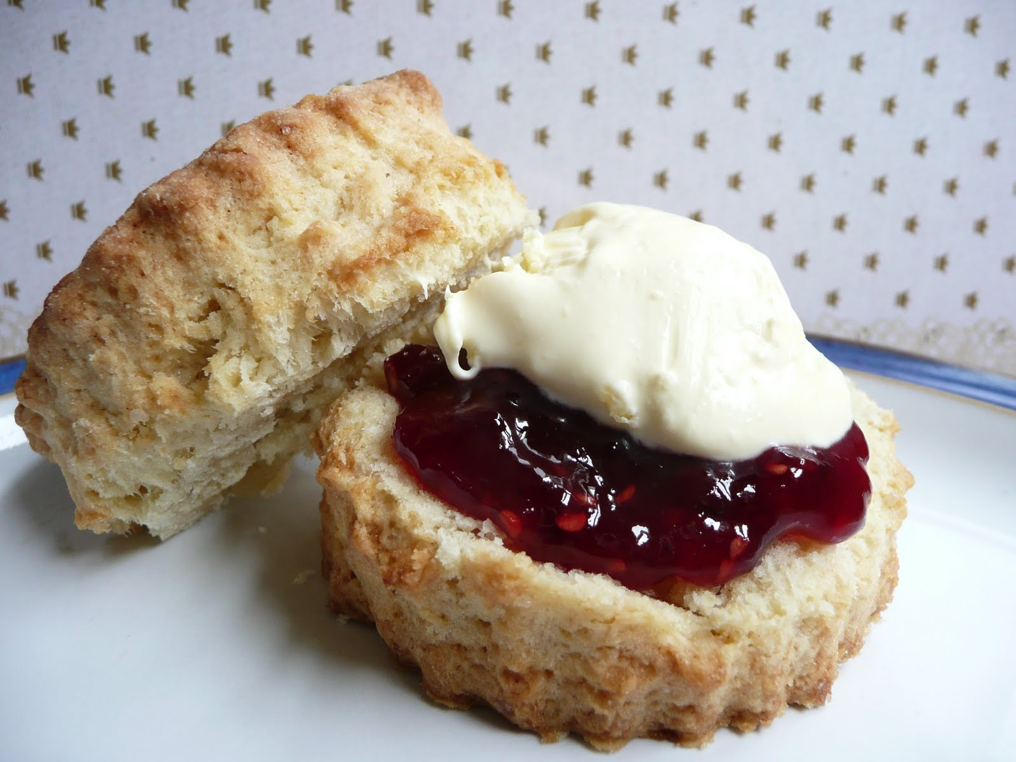
Scones

Slide 15
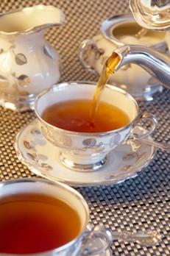
The English tea ceremony
The main secret of the English tea ceremony is hidden in it, of course. It is a very simple secret, though. Tea is brewed proceeding from the assumption that when in cups it will not be mixed with water anymore.

Slide 16
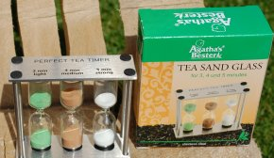
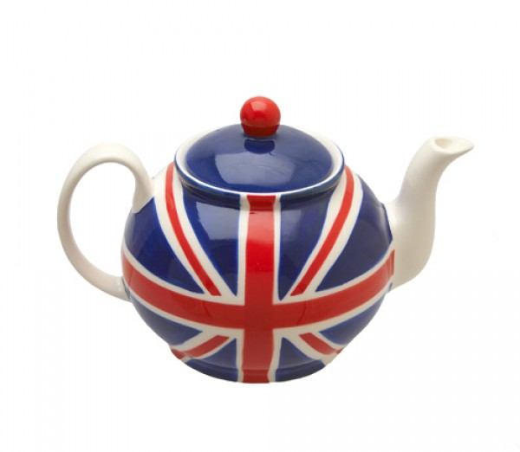
Put tea leaves into a pot (one teaspoon of tea in the pot for each person and one extra for the pot).
Tea is infused for 3-5 minutes (sometimes a sand glass may be used for control of time — it looks nice), and then poured out into cups.

Slide 17
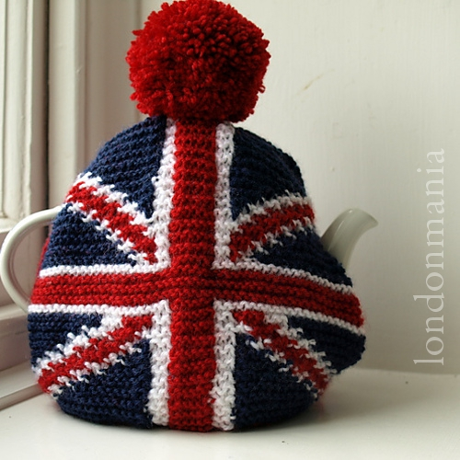
Tea-cozy
Teapot is covered with a tea-cozy not to get cold.

Slide 18
Do you know how to make traditional English tea? Put the actions in the right order to make a recipe.
1 2 3 4 5 6 7 8 9 10 | Add some milk. Place a tea strainer over the top of the cup. Warm the pot. Pour hot water into the pot. Brew for a few minutes. Tea is infused for 3-5 minutes (sometimes a sand glass may be used for control of time — it looks nice). Place a tea-cosy on the teapot to keep the tea warm. Boil the water in the kettle. Add some sugar. Put tea leaves into a pot (one teaspoon of tea in the pot for each person and one extra for the pot). Pour the tea in the cups.

Slide 19
Translate English proverbs about tea into Russian
1. Seven cups of it make you up in the morning; nine cups will put you to sleep at night.
2. The English know how to make tea and what it does for you.
3. If you take it in the middle of the morning, it will stimulate you for further work; if you drink it in the afternoon, it will relax you for further thought.
4. You should always find time for tea.
5. Where is tea, there is hope.

Slide 20
Match the idioms in English to their meanings in Russian
1. A storm in a teacup 2. Tea and sympathy 3. Another cup of tea 4. No for all the tea in China 5. Take tea with somebody 6. Make tea –not war 7. Be not one’s cup of tea 8. Read the tea leaves 9. Be one’s cup of tea 10. Husband’s tea 11. Be as good as a chocolate teapot 12. Builder’s tea | совсем другое дело завари чай, а не войну сама доброта крепкий чай иметь мало толку (как с козла молока) слабо заваренный чай то, что нравится, быть по вкусу буря в стакане воды ни за что на свете (ни за какие коврижки) не по душе вести дела, иметь с кем-либо деловые отношения предсказывать наобум (гадать на кофейной гуще)

Slide 21
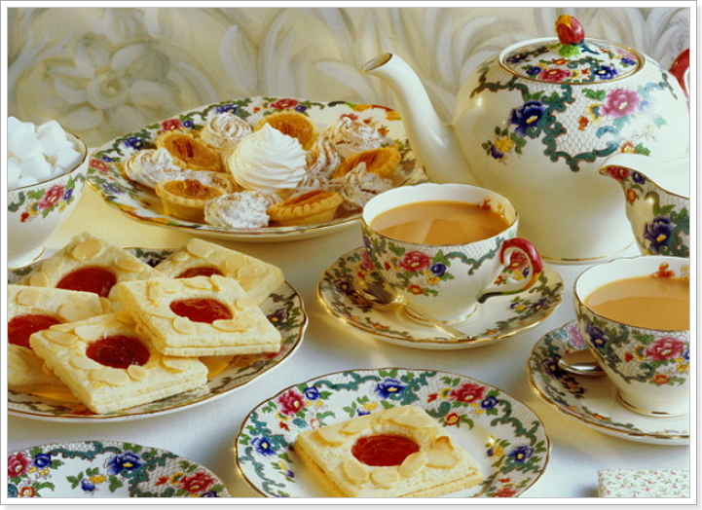
Make words of jumbled letters
caruse
sicubit
opesonat
dcihwasn
tcohl
kannip
nosce
teviseret
telap
rasertin

Slide 22
Pronounce Tongue-twisters
Betty bought some bitter butter and it made her batter bitter, so Betty bought some better butter to make her bitter batter better.
A proper cup of coffee from a proper copper coffee pot.
What did you have for breakfast? a box of mixed biscuits, and a biscuit mixer.
The greener green grapes are, the keener keen apes are to gobble green grape cakes, they're great! An Ape hates grape cakes.
She sees cheese.

Slide 23
Выдающийся британский премьер-министр XIX века сэр Уильям Гладстон (William Gladstone) посвятил чаю белый стих:
“If you are cold, tea will warm you; if you are too heated, it will cool you; If you are depressed, it will cheer you; If you are excited, it will calm you.”

Slide 24
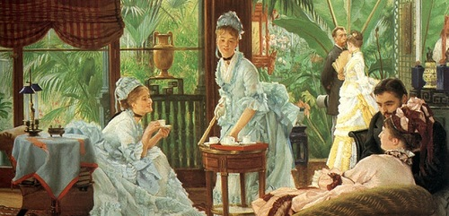
Приятного вам чаепития!

