Slide 1
Home exchange
made by: Pronina Svetlana
Stepanova Nastya

Slide 2
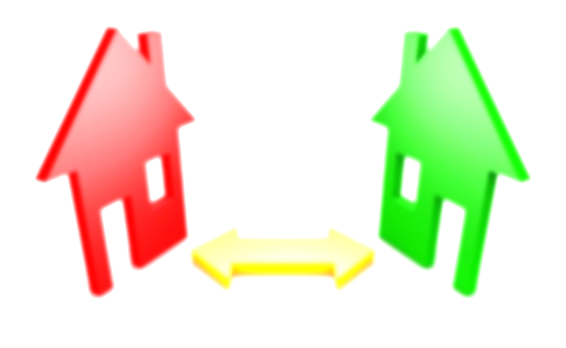
What is it?
“You stay in my house while I stay in yours”.
Home exchange, also known as house swapping, is a mean of travel accommodation, when two parties agree to swap their homes for a set period of time.

Slide 3
Home Exchange Types
The most popular is simultaneous home exchange, where two members of a home exchange website trade their homes.
A hospitality exchange, where exchangers take turns welcoming each other into their homes at a definite time.
Weekend getaways is for people who are able to work away from home and exchange their houses for the weekends.
Long-term swaps is for people who want to exchange their houses for a long period of time.

Slide 4
Why is it comfortable?
It’s cheaper than to live at the hotel.
You’ll learn more about culture of other countries (especially if you’ll use hospitality exchange).
You can communicate with people from all over the world and learn more about the place where you’ll stay.
You don’t need to buy a tour. Just buy tickets.

Slide 5
Some sites that have lists of home exchange clubs
Geenee .A beautiful website with Excellent worldwide coverage.
Global Home Exchange. Excellent website with worldwide coverage. You pay for listing your home but can search their listings for free.
Home Base Holidays. Located in London, England.
Homelink International. Worldwide. The largest home exchange service with over 15,000 members spread over 50 countries.
ExchangeHomes.com. Worldwide. They are one of the largest and most respected home exchange clubs around.

Slide 6
How to choose the house?
Read the description of the house attentively.
Discuss all details with the owner of the house.
Ask more questions about the area which is near with the house.
Learn all points of contract.

Slide 7
Our choice

Slide 8
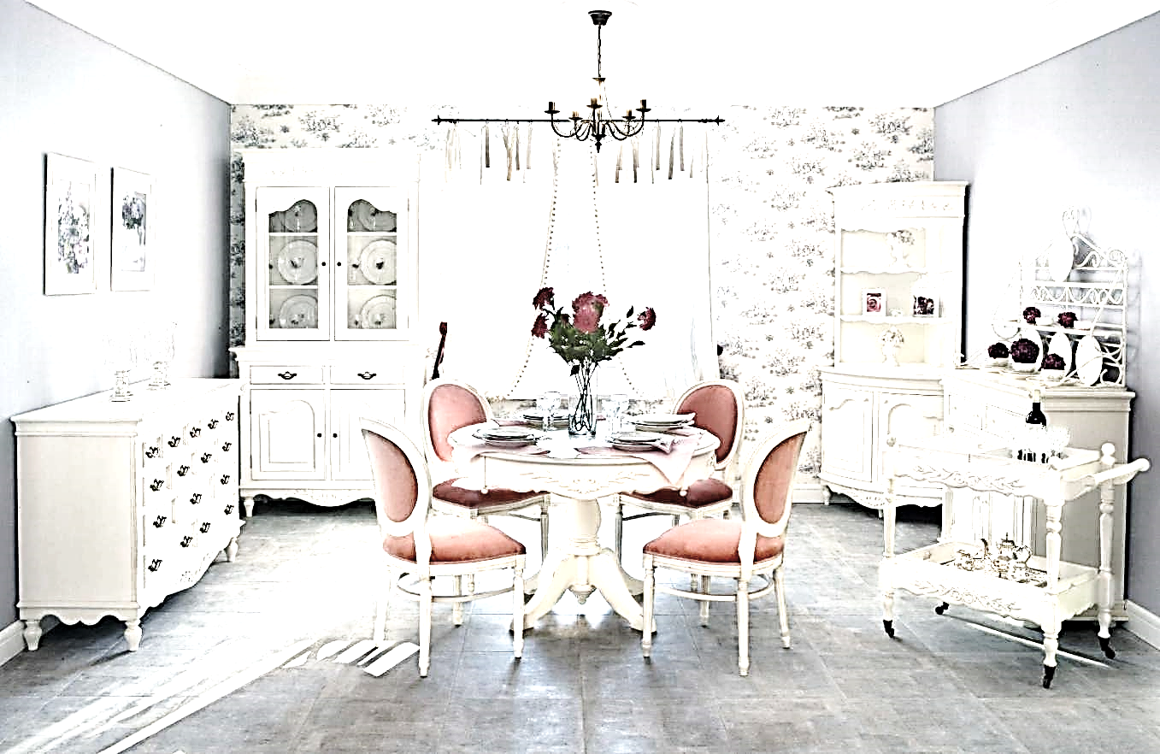
What will you choose?
Thank you for your attention

